Slide 1
+

Slide 2
Section 1
Plate Tectonics 板块构造学说

Slide 3
板块构造学说的出现
Early in the twentieth century as a relatively straightforward proposal called continental drift started one scientific revolution.
For more than 50 years, the scientific establishment categorically rejected the idea that continents are capable of movement.
Continental drift was particularly distasteful to North American geologists, perhaps because much of the supporting evidence had been gathered from the continents of Africa, South America, and Australia, with which most North American geologists were unfamiliar.
Notes:
For more than 50 years, the scientific establishment categorically rejected the idea that continents are capable of movement. Continental
drift was particularly distasteful to North American
geologists, perhaps because much of the supporting evidence
had been gathered from the continents of Africa, South America,
and Australia, with which most North American geologists
were unfamiliar.

Slide 4
二战后 至 1968年
Following World War II, modern instruments replaced rock hammers as the tools of choice for many researchers. Armed with more advanced tools, geologists and a new breed of researchers, including geophysicists and geochemists, made several surprising discoveries that began to rekindle interest in the drift hypothesis.
By 1968 these developments had led to the unfolding of a far more encompassing explanation known as the theory of plate tectonics.

Slide 5
Continental Drift: An Idea Before Its Time

Slide 6
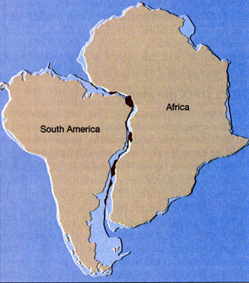
Notes:
The idea that continents, particularly South America an Africa, fit together like pieces of a jigsaw puzzle(七巧板) came about during the 1600s, as better world maps became available.

Slide 7
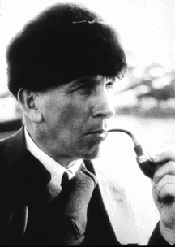
大陆漂移学说 continental drift
魏格纳(Wegener, 1880–1930)在1915年写出了《大陆和海洋的起源》一书，较完整地提出了这一学说，提出今天所知的南北美洲大陆、非洲大陆、欧亚大陆、南极大陆等是由大约2亿(200million)年前中生代(Mesozoic era)一块超级大陆(Pangaea, 泛大陆)分裂，经过漫长岁月的移动最终形成的。

Slide 8
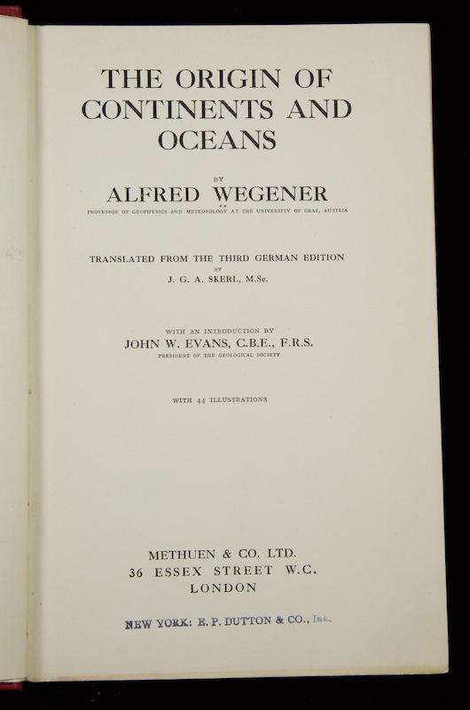

Slide 9
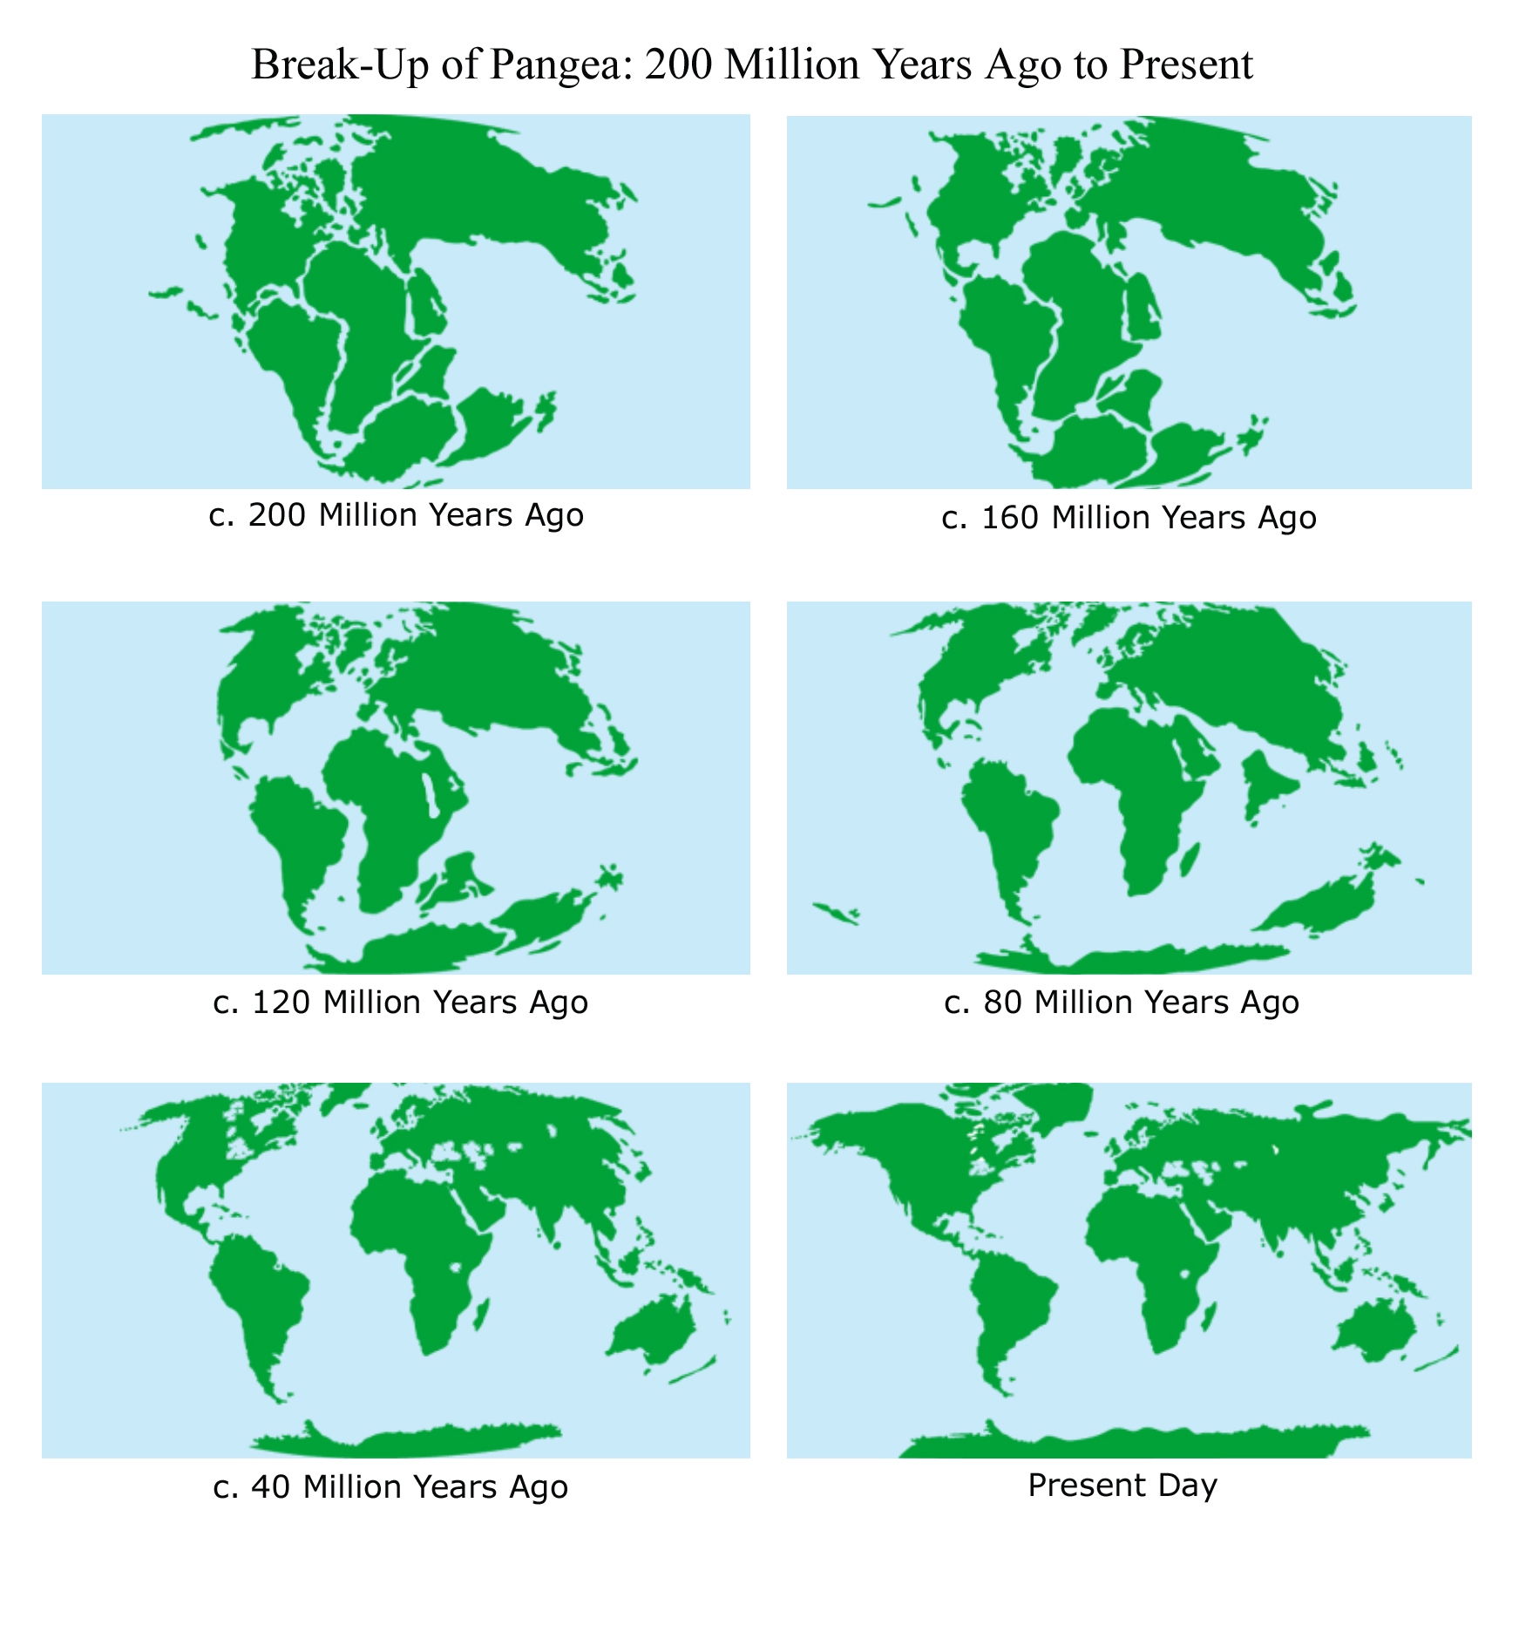

Slide 10
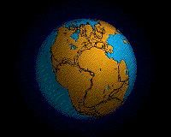
CONTINENTAL DRIFT
http://www.tectonics.caltech.edu/movies/outreach/sumatra/pangaea.mov
Notes:
http://www.stockton.edu/~hozikm/geol/Courses/The%20Earth/Content%20Web%20Pages/Rozmus/world.gif

Slide 12

Evidence1: The Continental Jigsaw Puzzle
大陆七巧板

Slide 13
Best fit of South America and Africa along the continental slope at a depth of 500 fathoms(英寻，about 900 meters.

Slide 14
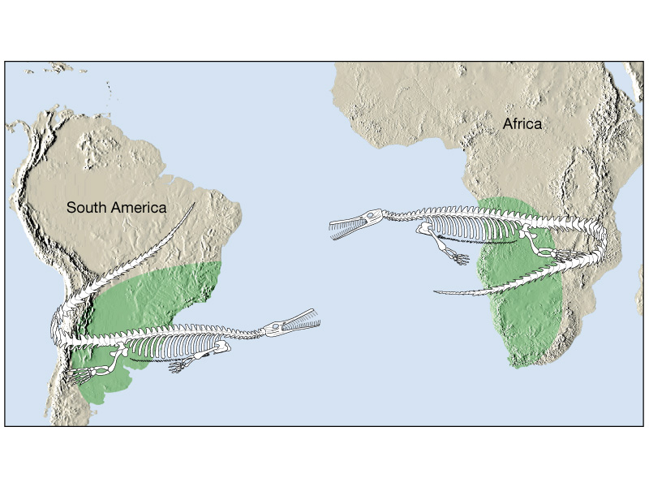
Evidence2: Fossils
Mesosaurus(中龙) was incapable of swimming across a large ocean.

Slide 15
中龙
A classic example is Mesosaurus, a small aquatic freshwater reptile whose fossil remains are limited to black shales of the Permian period (about 260 million years ago) in eastern South America and southwestern Africa.
If Mesosaurus had been able to make the long journey across the South Atlantic, its remains would likely be more widely distributed. As this is not the case, Wegener asserted that South America and Africa must have been joined during that period of Earth history.

Slide 17
冰期大猜测
We know, for example, that during the Ice Age that ended about 8000 years ago, the lowering of sea level allowed mammals (including humans) to cross the narrow Bering Strait that separates Russia and Alaska.
Was it possible that land bridges once connected Africa and South America but later subsided below sea level? Modern maps of the seafloor substantiate Wegener’s contention that if land bridges of this magnitude once existed, their remnants would still lie below sea level.

Slide 18
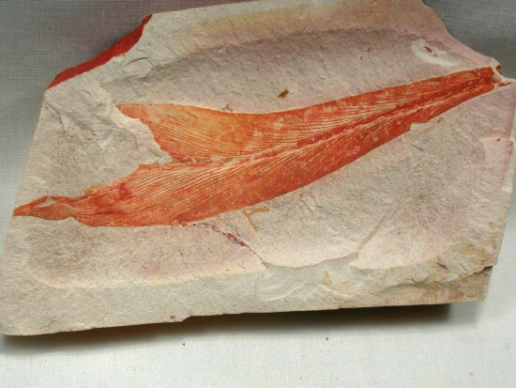
Glossopteris 舌羊齿

Slide 19
舌羊齿
Wegener also cited the distribution of the fossil “seed fern” Glossopteris as evidence for the existence of Pangaea (see Figure 7.4).
This plant, identified by its tongue-shaped leaves and seeds that were too large to be carried by the wind, was known to be widely dispersed among Africa, Australia, India, and South America.
Later, fossil remains of Glossopteris were also discovered in Antarctica.* Wegener also learned that these seed ferns and associated flora grew only in cool climates—similar to central Alaska.
Therefore, he concluded that when these landmasses were joined, they were located much closer to the South Pole.
Notes:
In 1912 Captain Robert Scott and two companions froze to death lying beside 3 pounds (16 kilograms) of rock on their return from a failed attempt to be the first to reach th South Pole. These samples, collected on the moraines of Beardmore Glacier, contained fossil remains of Glossopteris.

Slide 20
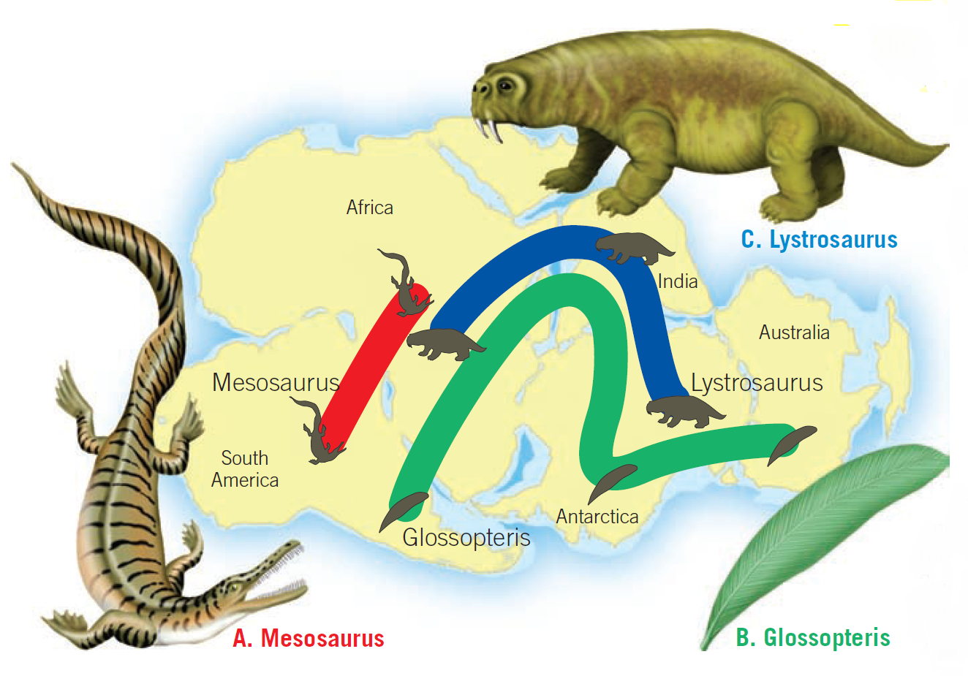

Slide 21

jigsaw puzzle

Slide 22
Evidence:
Rock Types and Geologic Features
Anyone who has worked a jigsaw puzzle knows that its successful completion requires that you fit the pieces together while maintaining the continuity of the picture.
The “picture” that must match in the “continental drift puzzle” is one of rock types and geologic features such as mountain belts.
If the continents were together, the rocks found in a particular region on one continent should closely match in age and type those found in adjacent positions on the once adjoining continent.
Wegener found evidence of 2.2-billion-year-old igneous rocks in Brazil that closely resembled similarly aged rocks in Africa.

Slide 23
The mountain belt that includes the Appalachians trends northeastward through the eastern United States and disappears off the coast of Newfoundland. Mountains of comparable age and structure are found in the British Isles, western Africa, and Scandinavia（斯堪的纳维亚）.

Slide 24
Evidence3: Ancient Climates

Slide 25
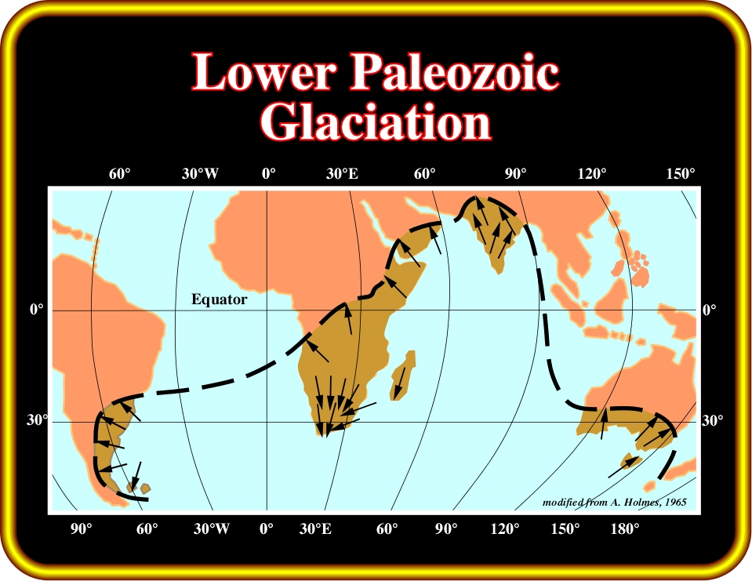
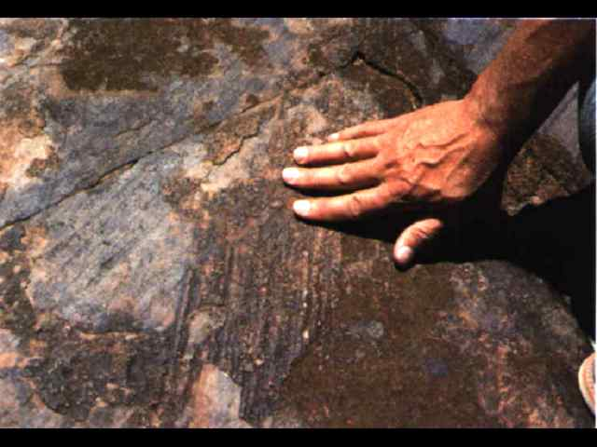
晚古生代冰川

Slide 26
Much of the land area that contains evidence of this period of Paleozoic glaciation presently lies within 30° of the equator, in subtropical or tropical climates.

Slide 27
其中的一种解释
One proposal suggested that our planet experienced a period of extreme global cooling.
Wegener rejected this explanation because during the same span of geologic time, large tropical swamps existed in several locations in the Northern Hemisphere.

Slide 28
魏格纳何以知道晚古生代
有热带沼泽？
The lush vegetation in these swamps was eventually buried and converted to coal. Today these deposits comprise major coal fields in the eastern United States and Northern Europe.

Slide 29
然而煤炭的形成和气候没有必然的联系，只要有足够的植物被掩埋。
所以还需要一些化石的支撑

Slide 30
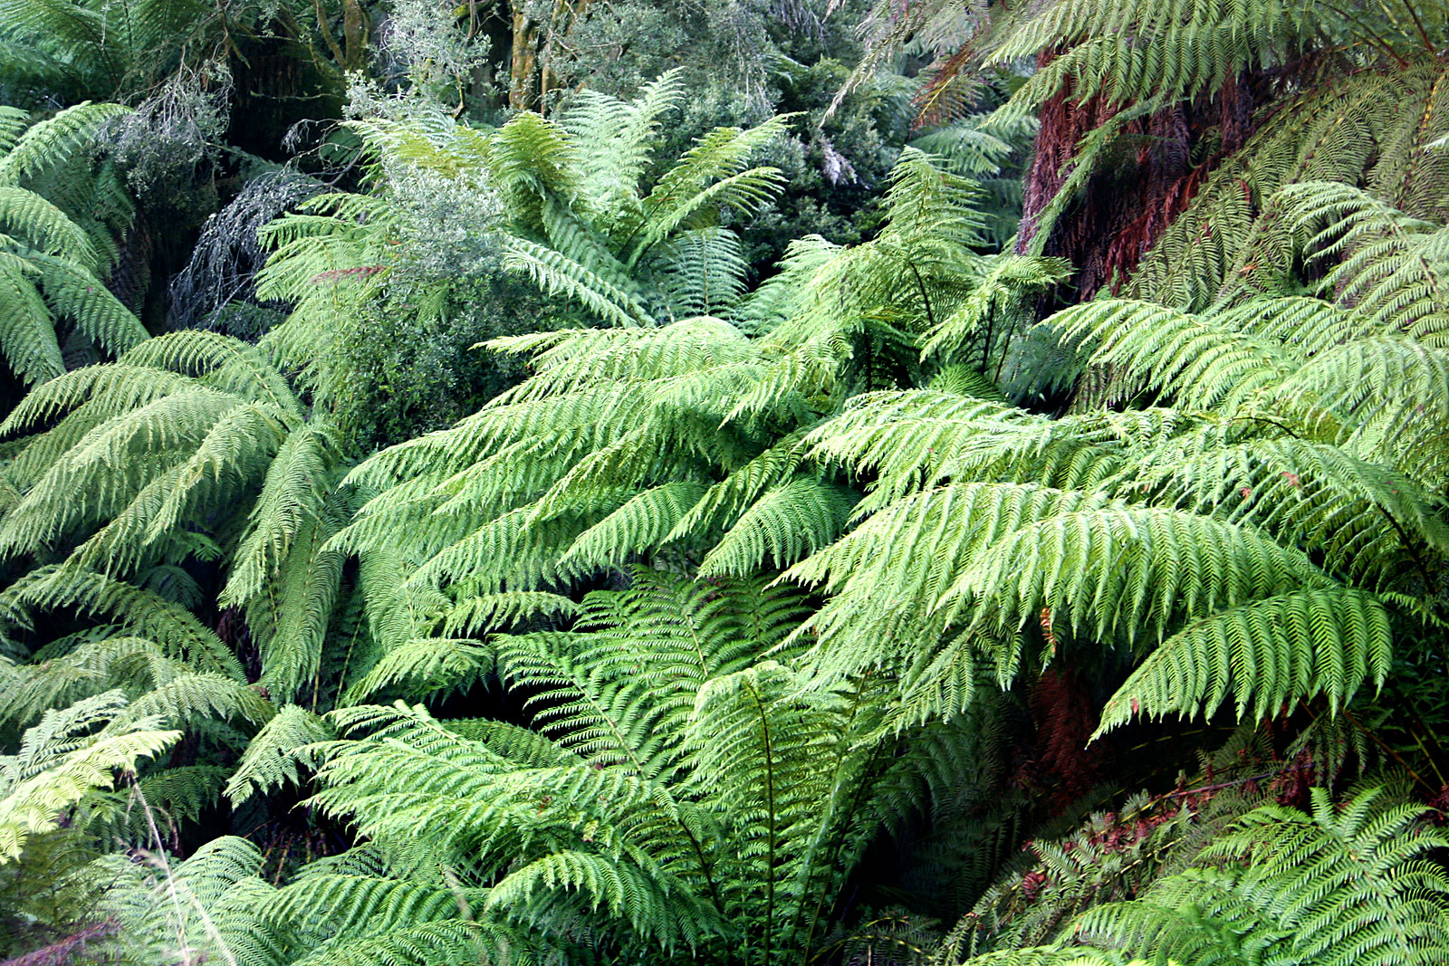

Slide 31
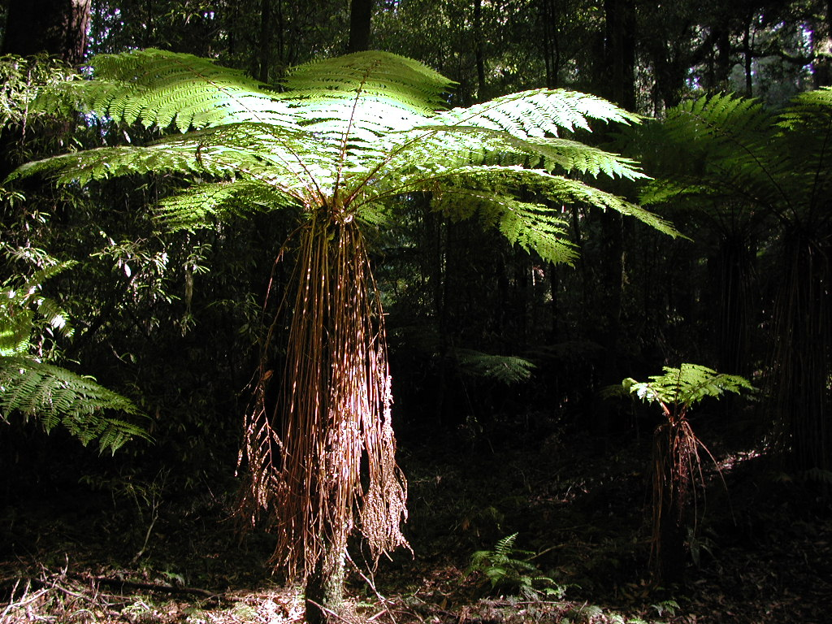

Slide 32
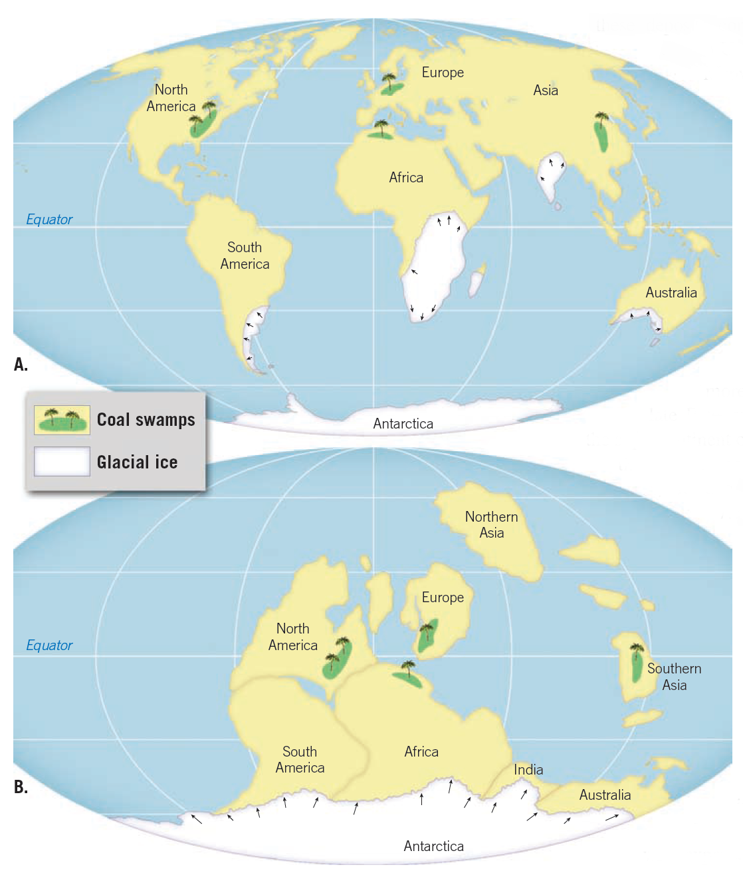

Slide 33
泛大陆及大陆漂移可以解释同时解释冰川覆盖和热带沼泽
Wegener suggested that a more plausible explanation for the late Paleozoic glaciation was provided by the supercontinent of Pangaea.
In this configuration, the southern continents are joined together and located near the South Pole. This would account for the conditions necessary to generate extensive expanses of glacial ice over much of these landmasses.
At the same time, this geography would place today’s northern continents nearer the equator and account for the tropical swamps that generated the vast coal deposits.

Slide 34
Wegener’s proposal did not attract much open criticism until 1924, when his book was translated into English, French, Spanish, and Russian.
From that point until his death in 1930, the drift hypothesis encountered a great deal of hostile criticism.

Slide 35
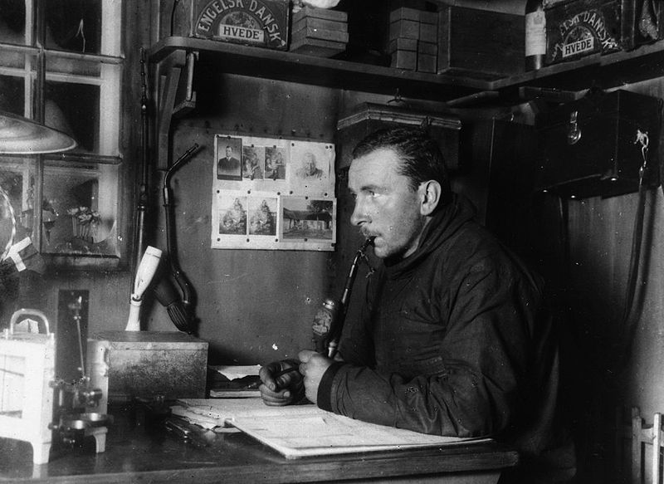
魏格纳临终前,大陆漂移学说也
没得到普遍接受。
Notes:
Alfred Wegener in Greenland in the winter of 1912-13.

Slide 36
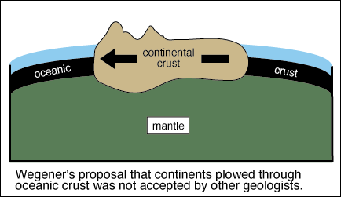
魏格纳对大陆漂移动力来源的解释

Slide 37
Rejection of the Drift Hypothesis
One of the main objections to Wegener’s hypothesis stemmed from his inability to identify a credible mechanism for continental drift.
Wegener proposed that gravitational forces of the Moon and Sun that produce Earth’s tides were also capable of gradually moving the continents across the globe.
However, the prominent physicist Harold Jeffreys correctly countered that tidal forces strong enough to move Earth’s continents would have resulted in halting our planet’s rotation, which, of course, has not happened.

Slide 38
Rejection of the Drift Hypothesis
Wegener also incorrectly suggested that the larger and sturdier continents broke through thinner oceanic crust, much as ice breakers cut through ice.
However, no evidence existed to suggest that the ocean floor was weak enough to permit passage of the continents without the continents being appreciably deformed in the process.

Slide 39
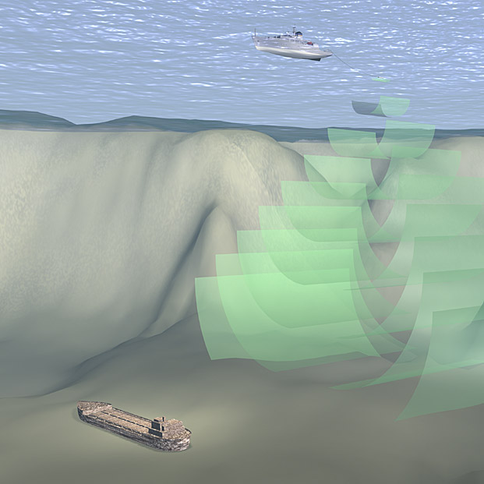
60 years ago, in the 1950’s, Sonar was invented.

Slide 40
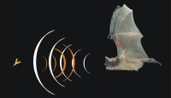
Bats use it!

Slide 41
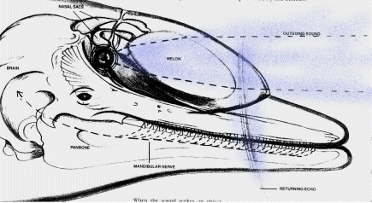
So do dolphins!

Slide 42
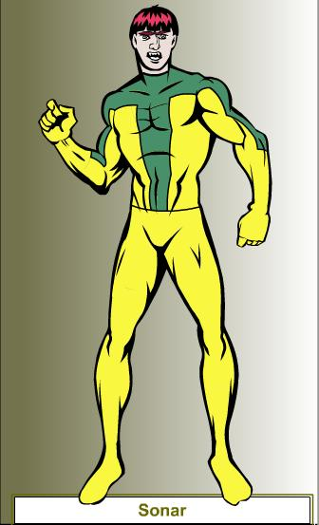
So does Ocean Man

Slide 43
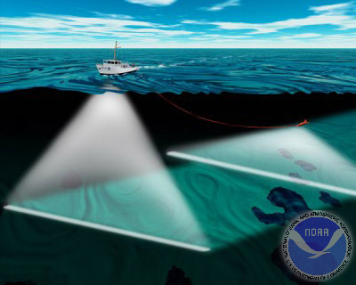
Sonar brought Wegner’s theory back to life!

Slide 44
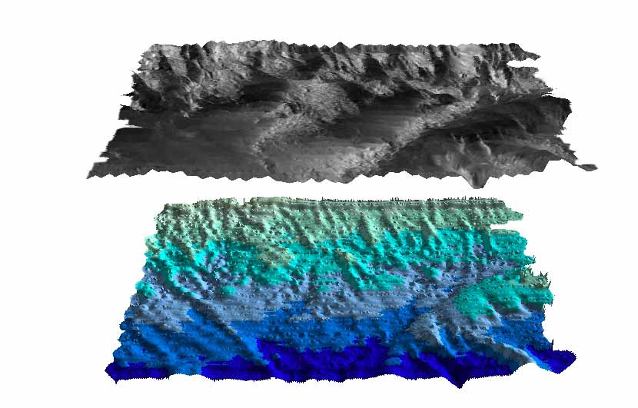
Sonar made it possible for us to observe the ocean floor.

Slide 45
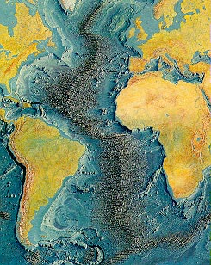
Soon, scientists observed a large mountain chain running down the center of the Atlantic ocean.

Slide 46
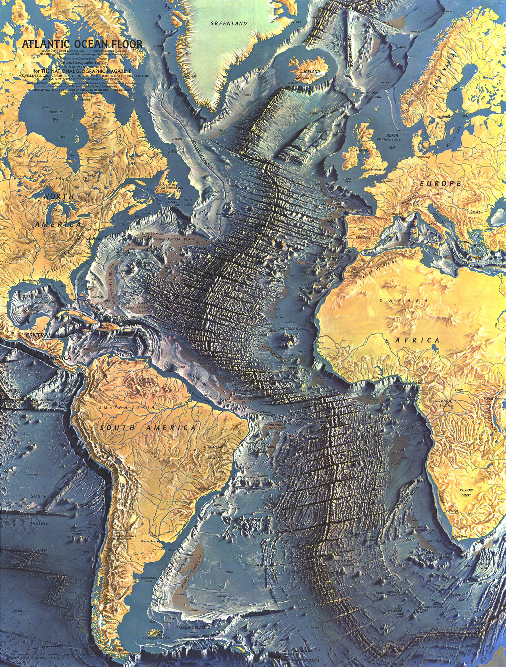

Slide 47
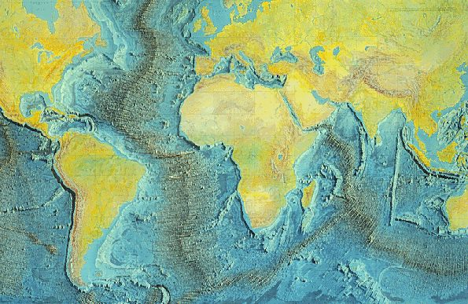
They quickly found that the ridge ran around the world!

Slide 48
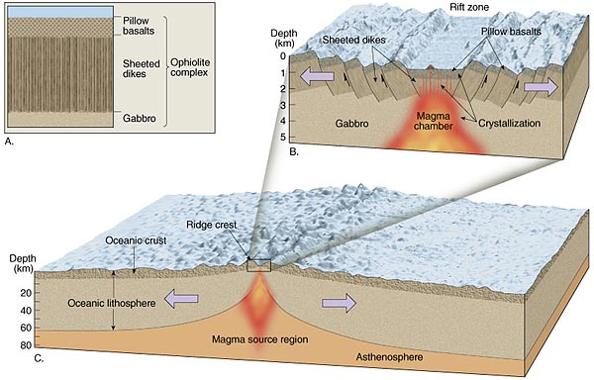
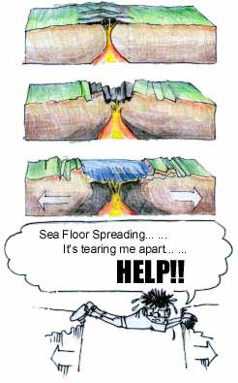

Slide 49
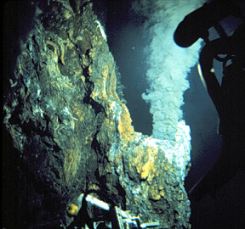

Slide 50
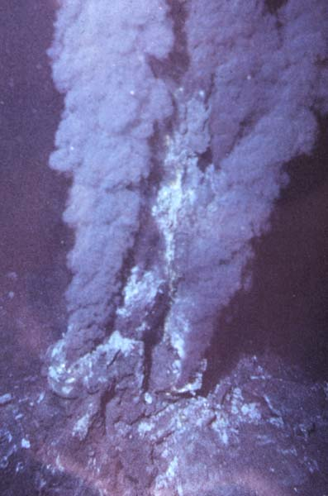

Slide 51
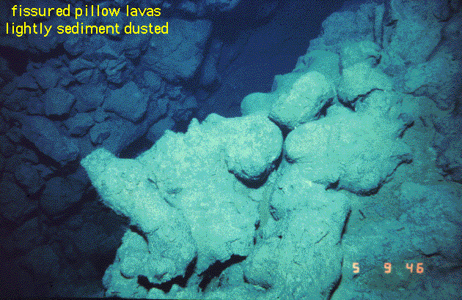
Pillow Lava(枕熔岩) forms when magma cools in water. This is evidence of volcanic activity!

Slide 52
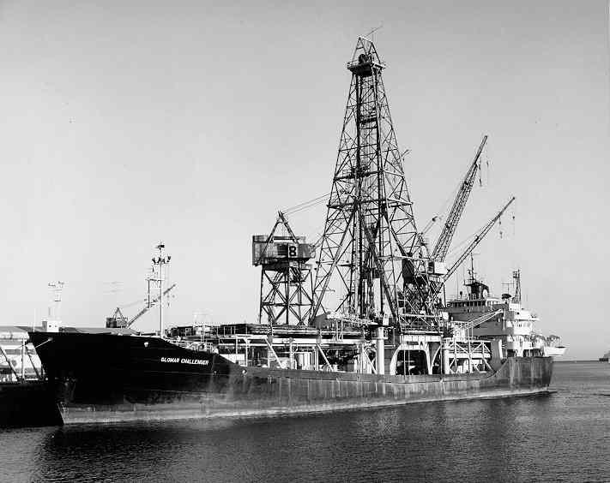
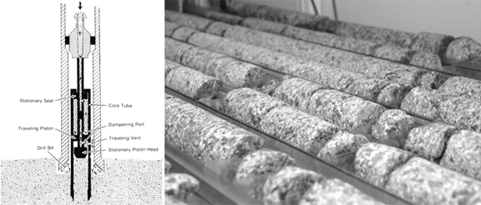
Glomar Challenger
格罗玛·挑战者号
Notes:
In 1968, scientists aboard the research ship Glomar Challenger began gathering information about the rocks on the seafloor. Glomar Challenger was equipped with a drilling rig that allowed scientists to drill into the seafloor to obtain rock samples. Scientists found that the youngest rocks are located at the mid-ocean ridges. The ages of the rocks become increasingly older in samples obtained farther from the ridges, adding to the evidence for seafloor spreading.

Slide 53

Evidence: Ocean Drilling
Some of the most convincing evidence for seafloor spreading came from the Deep Sea Drilling Project, which operated from 1968 until 1983. One of the early goals of the project was to gather samples of the ocean floor in order to establish its age.
To accomplish this, the Glomar Challenger, a drilling ship capable of working in water thousands of meters deep, was built. Hundreds of holes were drilled through the layers of sediments that blanket the ocean crust, as well as into the basaltic rocks below.

Slide 54
Evidence: Ocean Drilling
Rather than radiometrically date the crustal rocks, researchers used the fossil remains of microorganisms found in the sediments resting directly on the crust to date the seafloor at each site.
Radiometric dates of the ocean crust itself are unreliable because of the alteration of basalt by seawater.
The thickness of ocean-floor sediments provided additional verification(证实) of seafloor spreading.

Slide 56
结果如何？
Drill cores from the Glomar Challenger revealed that sediments are almost entirely absent on the ridge crest and that sediment thickness increases with increasing distance from the ridge.
This pattern of sediment distribution should be expected if the seafloor-spreading hypothesis is correct.

Slide 57
相对地，海底的岩石都年轻
The data collected by the Deep Sea Drilling Project also reinforced the idea that the ocean basins are geologically young because no seafloor with an age in excess of 180 million years was found.
By comparison, most continental crust exceeds several hundred million years in age, and some has been located that exceeds 4 billion years in age.

Slide 58
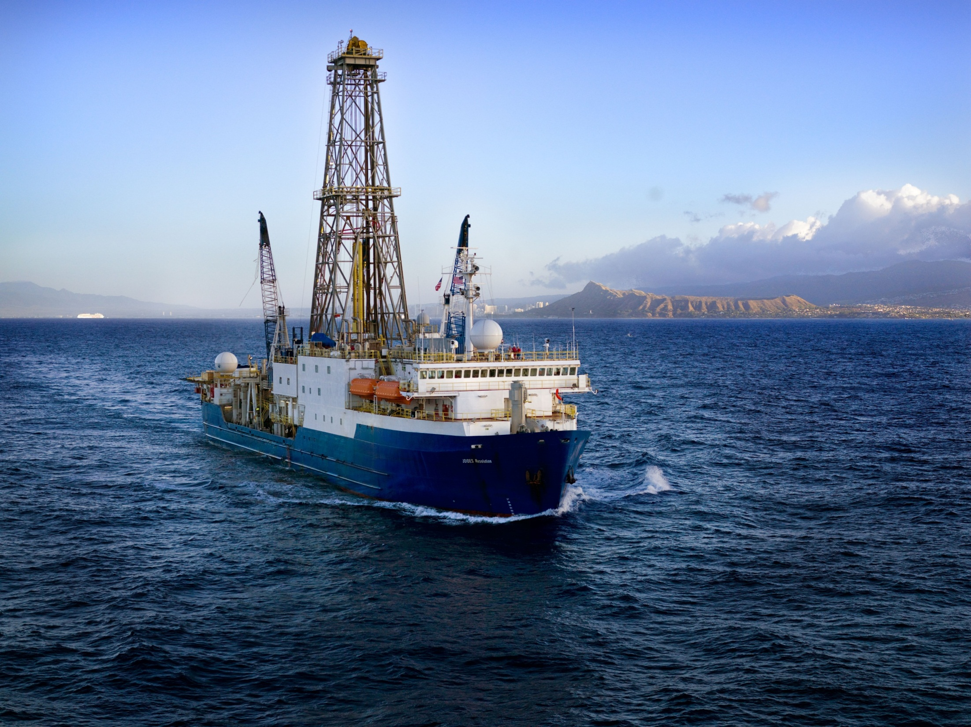
Chikyu（地球号） is a state-of-the-art（最先进的）
drilling ship designed to drill up to 7,000 meters
(more than 4 miles) below the seafloor.

Slide 59
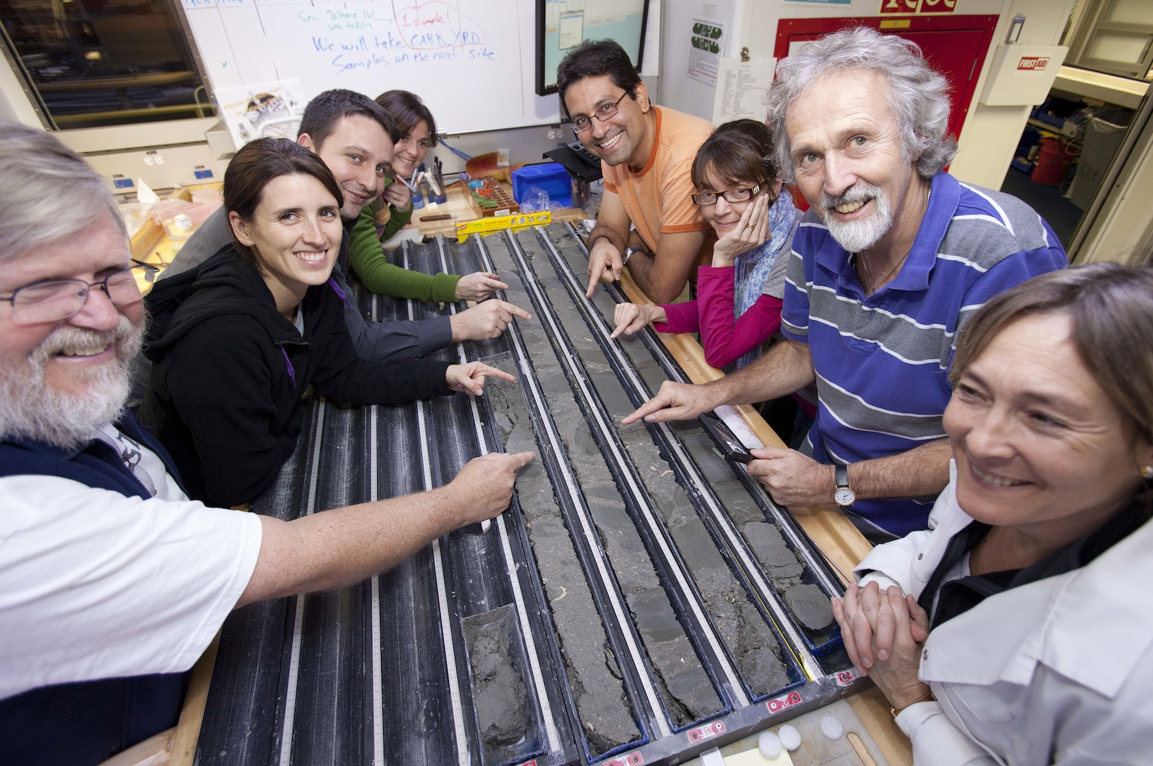

Slide 60
Chikyu（地球号）介绍
In October 2003, the JOIDES Resolution became part of a new program, the Integrated Ocean Drilling Program (IODP).
This new international effort uses multiple vessels for exploration, including the massive 210-meterlong (nearly 770-foot-long) Chikyu (meaning “planet Earth” in Japanese), which began operations in 2007.
One of the goals of the IODP is to recover a complete section of the ocean crust, from top to bottom.

Slide 61
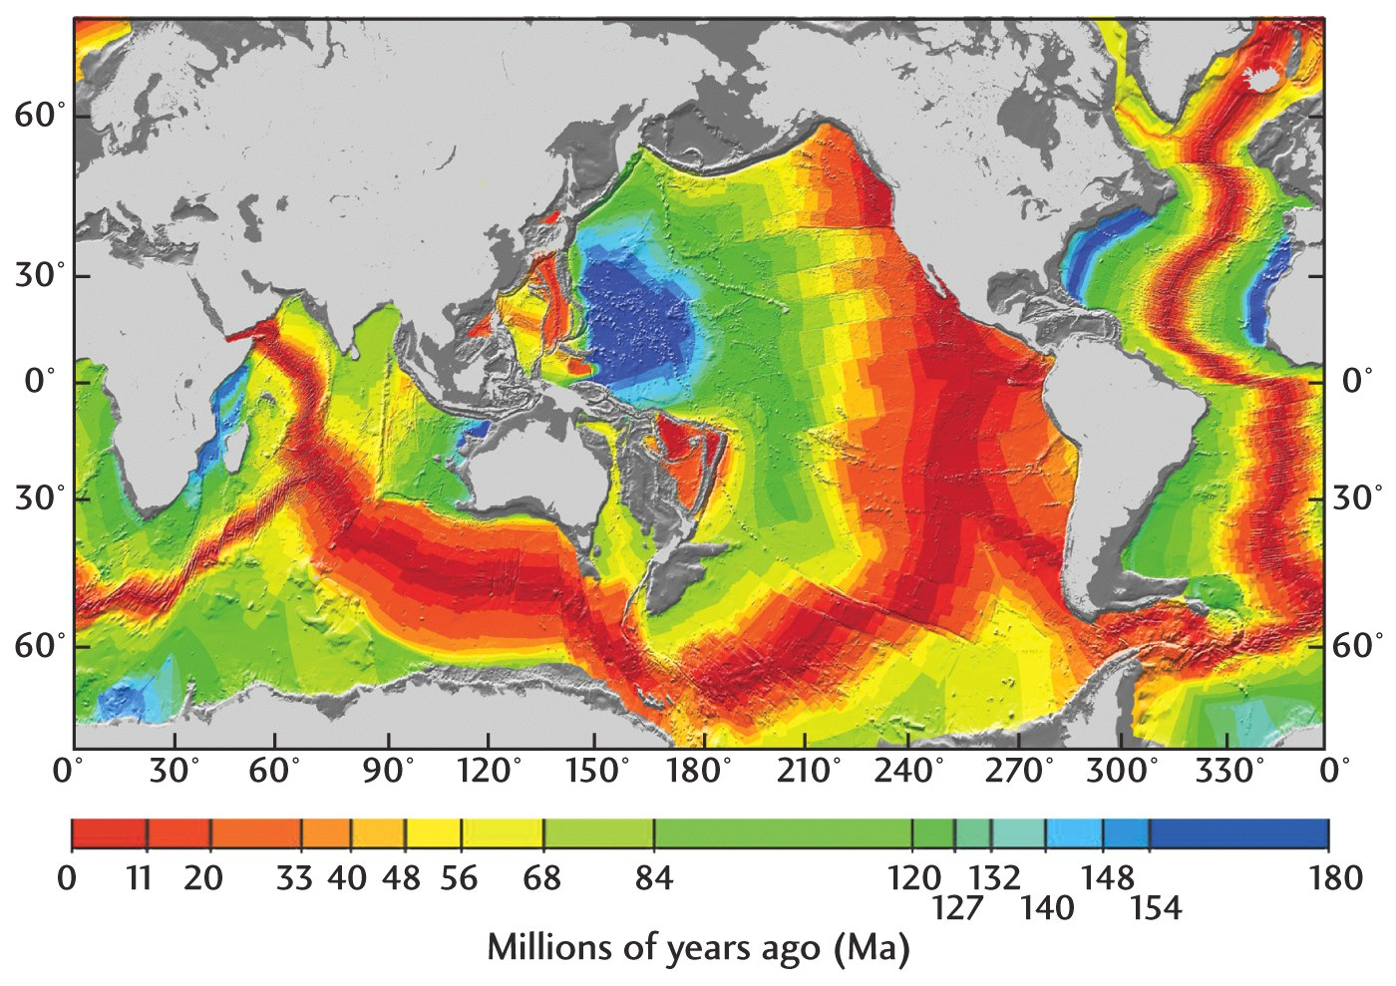

Slide 62
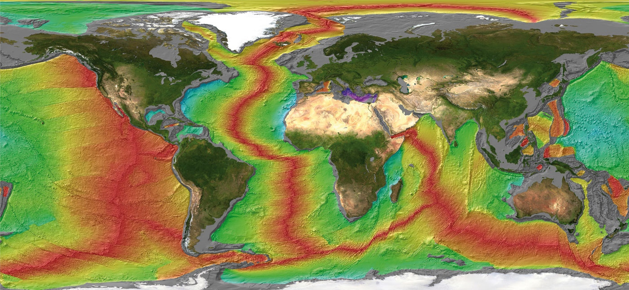
发现一：
海底的岩石，越靠近海脊，其年龄越低

Slide 63
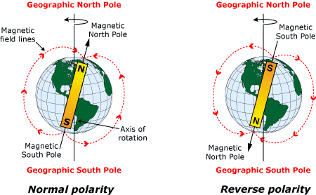
地球发生过多次地磁场南北极互换的现象——地磁倒转(magnetic reversal)
正磁极
反磁极

Slide 64
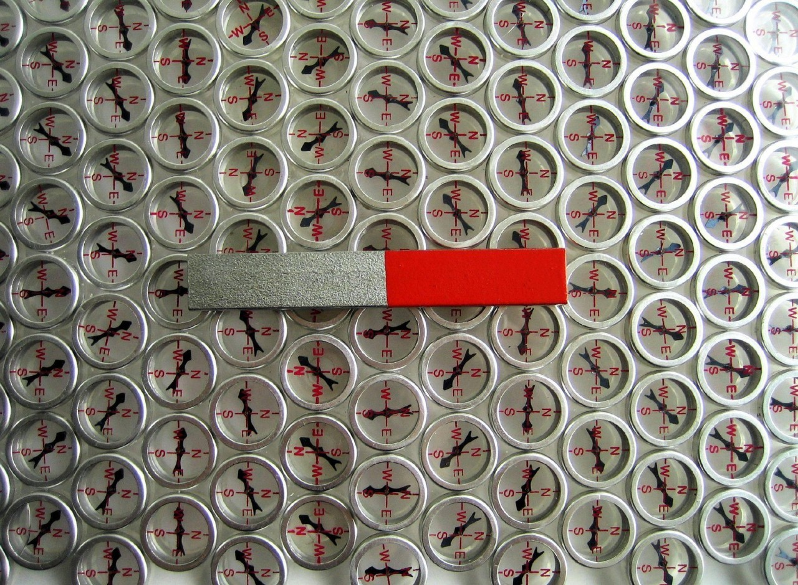

Slide 65
磁铁矿——地磁倒转的天然记录
Iron-bearing minerals, such as magnetite(磁铁矿,Fe₃O₄), that are found in the rocks of the seafloor can record Earth’s magnetic field direction when they form.
Whenever Earth’s magnetic field reverses, newly forming iron minerals will record the magnetic reversal.

Slide 66
Curie point 居里点
One of the most common is the iron-rich mineral magnetite, which is abundant in lava flows of basaltic composition.
Basaltic lavas erupt at the surface at temperatures greater than 1000°C (1800°F), exceeding a threshold temperature for magnetism known as the Curie point (about 585°C [1085° F]).
Consequently, the magnetite grains in molten lava are nonmagnetic. However, as the lava cools, these iron-rich grains become magnetized and align themselves in the direction of the existing magnetic lines of force.

Slide 67
Paleomagnetism 古磁性
Once the minerals solidify, the magnetism they possess usually remains “frozen” in this position. Thus, they act like a compass needle because they “point” toward the position of the magnetic poles at the time of their formation.
Rocks that formed thousands or millions of years ago and contain a “record” of the direction of the magnetic poles at the time of their formation are said to possess paleomagnetism, or fossil magnetism.

Slide 68
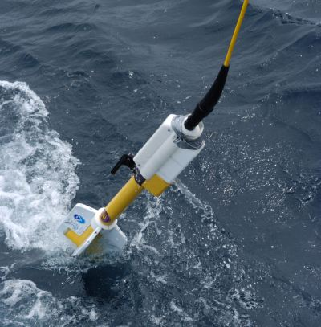
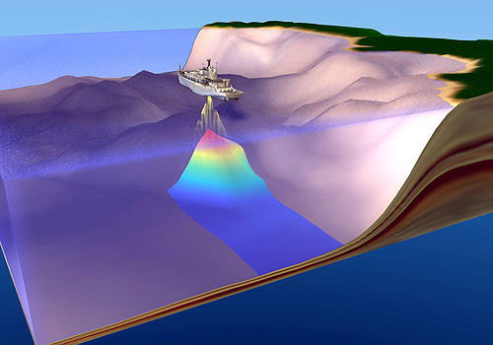
Magnetometer 磁强计
可检测海底岩石产生的磁场

Slide 70
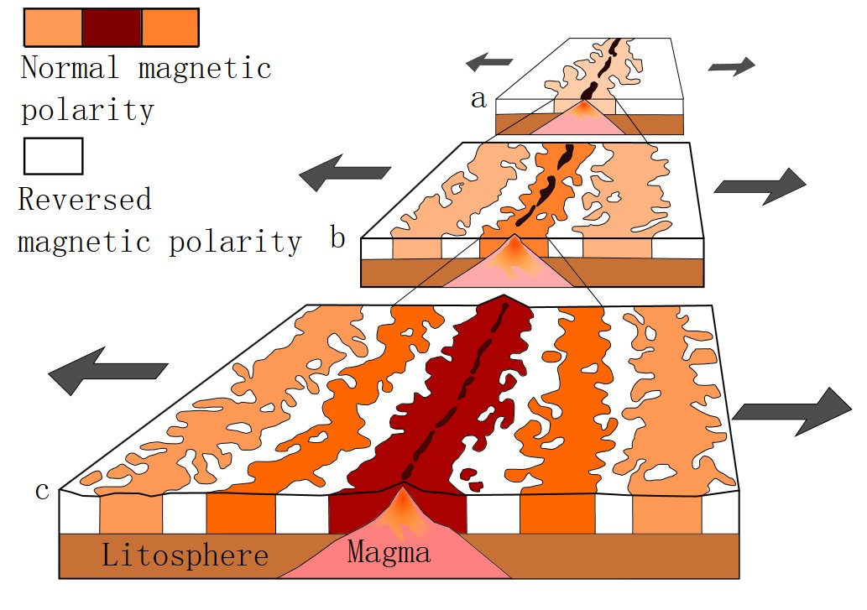

Slide 71
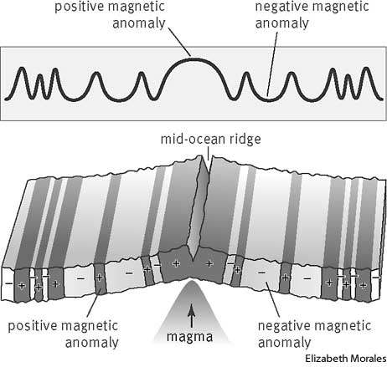
发现二：
海底岩石产生的磁场，于海脊两侧对称分布,且正负磁交替排列

Slide 72
Evidence:
Mantle Plumes and Hot Spots
Mapping volcanic islands and seamounts (submarine volcanoes) in the Pacific Ocean revealed several linear chains of volcanic structures.
One of the most-studied chains consists of at least 129 volcanoes that extend from the Hawaiian islands to Midway Island and continue northwestward toward the Aleutian trench (Figure 7.28).
Radiometric dating of this linear structure, called the Hawaiian Island–Emperor Seamount chain, showed that the volcanoes increase in age with increasing distance from the Big Island of Hawaii. The youngest volcanic island in the chain (Hawaii) rose from the ocean floor less than 1 million years ago, whereas Midway Island is 27 million years old, and Detroit Seamount, near the Aleutian trench, is about 80 million years old.

Slide 74
Five million years ago, when Kauai was positioned over the hot spot, it was the only modern Hawaiian island in existence.
Visible evidence of the age of Kauai can be seen by examining its extinct volcanoes, which have been eroded into jagged peaks and vast canyons. By contrast, the relatively young island of Hawaii exhibits many fresh lava flows, and one of its five major volcanoes, Kilauea, remains active today.

Slide 75
mantle plume
Most researchers agree that a cylindrically shaped upwelling of hot rock, called a mantle plume, is located beneath the island of Hawaii.
As the hot, rocky plume ascends through the mantle, the confining pressure drops, which triggers partial melting. (This process, called decompression melting, is discussed in Chapter 9.)

Slide 76
hot spot & hot-spot track
The surface manifestation of this activity is a hot spot, an area of volcanism, high heat flow, and crustal uplifting that is a few hundred kilometers across.
As the Pacific plate moved over a hot spot, a chain of volcanic structures known as a hot-spot track was built. As shown in Figure 7.28, the age of each volcano indicates how much time has elapsed since it was situated over the mantle plume.

Slide 77
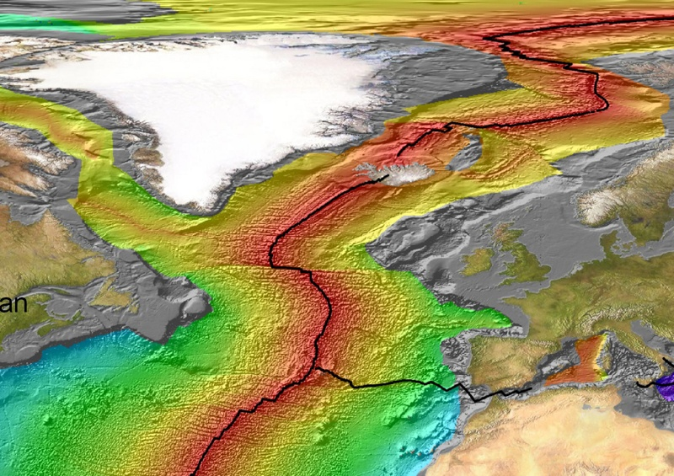
Iceland and Mid-Atlantic Ridge

Slide 78
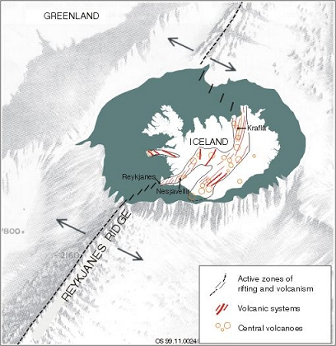
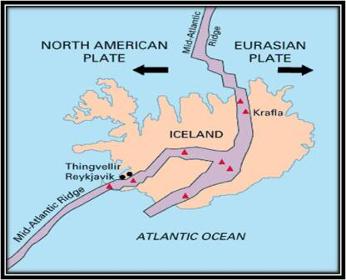
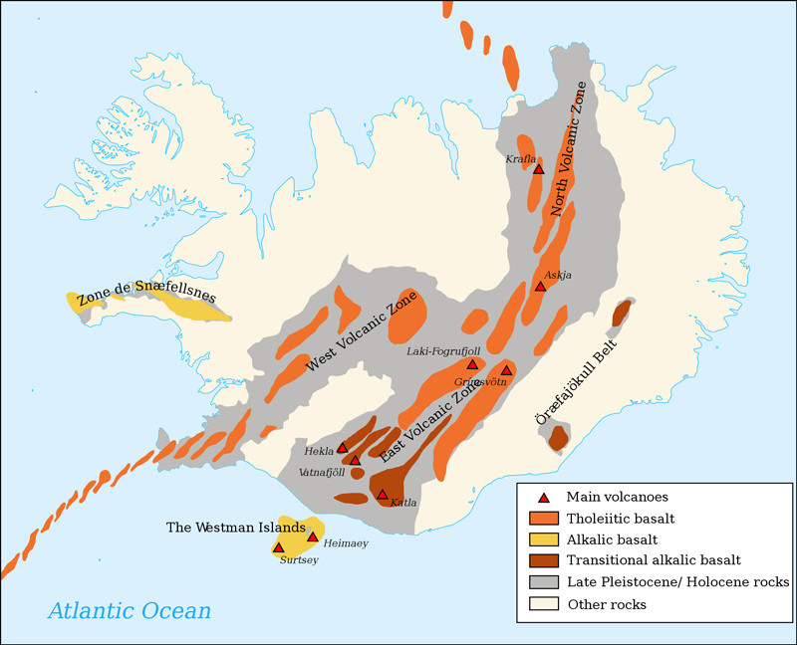
Iceland is spreading open on the Mid-Atlantic Ridge!

Slide 79
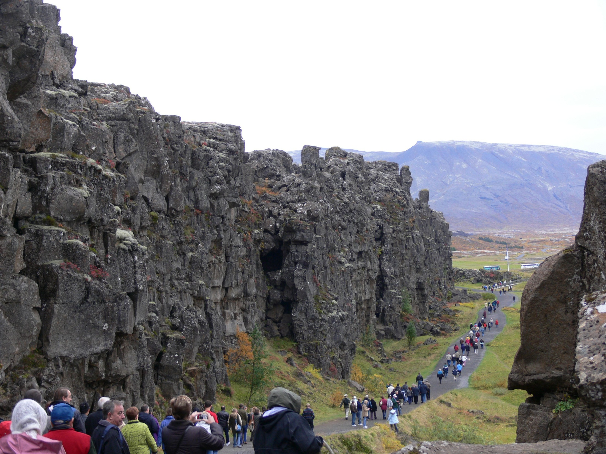
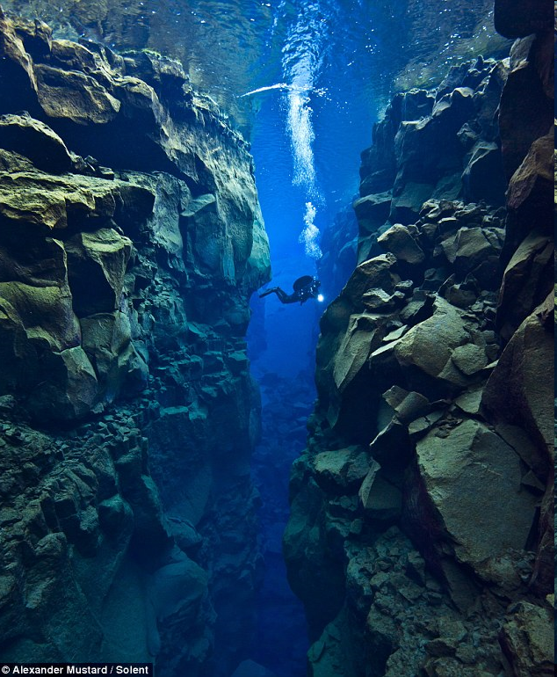

Slide 80
If new crust is being added to Earth’s surface, is Earth getting bigger?

Slide 81
Subduction(俯冲) is a process where the ocean floor sinks back into the mantle at a deep ocean trench(海沟).

Slide 82
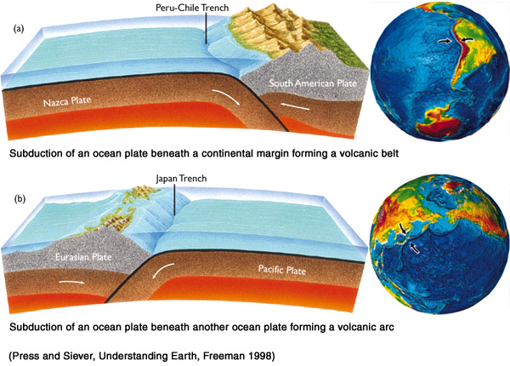

Slide 83
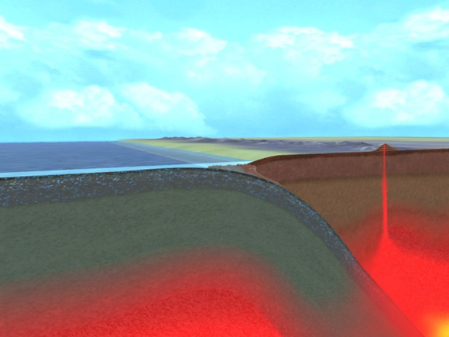
俯冲带部分物质会被重新喷出地表，
形成火山。

Slide 84
When a descending oceanic slab reaches a depth of about 100 kilometers (60 miles), melting is triggered within the wedge of hot asthenosphere that lies above it. But how does the subduction of a cool slab of oceanic lithosphere cause mantle rock to melt?
The answer lies in the fact that water contained in the descending plates acts the way salt does to melt ice. That is, “wet” rock in a high-pressure environment melts at substantially lower temperatures than does “dry” rock of the same composition.

Slide 85
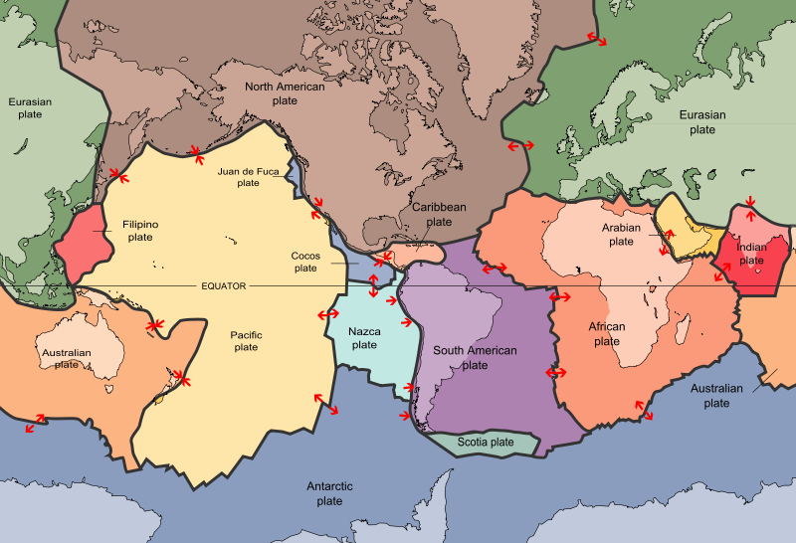


Slide 86



圣海伦斯火山

Slide 87
The Cascade Range
喀斯喀特山脉
The Cascade Range in Washington, Oregon, and California is another mountain system that consists of several wellknown volcanic mountains, including Mount Rainier, Mount Shasta, Mount St. Helens, and Mount Hood.
This active volcanic arc also extends into Canada, where it includes Mount Garibaldi, Mount Silverthrone, and others.

Slide 88


Slide 89

圣海伦斯火山位于
华盛顿州，美国西北部

Slide 90


Slide 91

海底扩张理论总览

Slide 92
Seafloor spreading
海底扩张理论
Seafloor spreading is the theory that explains how new ocean crust is formed at ocean ridges(海脊) and destroyed at deep-sea trenches(海沟).

Slide 93
Harry Hess : American Geologist

Slide 94

No! Harry Hess, not Harry Potter!

Slide 95

Sea-Floor Spreading
Harry Hess

Slide 97
海底扩张学说
现代科学技术特别是海洋探测技术的飞速发展，使地球科学家们开始了对海洋盆地以及洋底岩石学的研究。从20世纪50年代开始，科学家揭示出洋底的基本面貌。1960～1962年，赫斯和迪茨提出了“海底扩张说” ，以地幔对流说为基础，认为地球内部的地幔物质在大洋中部上涌，向两边溢流，并推开旧有的洋底物质，逐渐向两侧对称地扩张，形成新的洋底。

Slide 98
板块构造学说 plate tectonics
20世纪60年代以来，勒皮雄等人把大陆漂移和海底扩张的概念发展成为著名的“板块构造说”。
板块构造学说理论是在大陆漂移学说、海底扩张学说的基础上发展起来的。
Notes:
基本观点是：①地球的岩石圈划分为许多板块，②岩石圈板块是在软流圈上滑动的，③岩石圈板块之间在相互运动，④板块作用的驱动力是地幔对流作用。

Slide 99

萨维尔·勒皮雄(Xavier Le Pichon)
法国地质学家，法兰西学院教授。在他的众多贡献中，最负盛名的是1968年提出的板块构造学说的综合模型。

Slide 100

岩石圈的六大板块

Slide 101


Slide 102

岩石圈的六大板块(中国课本版)

Slide 103
板块构造学说的基本观点
1. 地球的岩石圈并不是完整的一块，而是被断裂带分割成六大板块: 亚欧板块，非洲板块，美洲板块，印度洋板块，南极洲板块，太平洋板块。大板块之内有若干小板块。
2.各大板块漂浮在软流层之上，处于不断运动之中

Slide 104
岩石圈的六大板块(中国课本版)

Slide 105
岩石圈板块(国外详细版)

Slide 106
板块构造学说的基本观点
3. 一般来说，板块内部地壳相对比较稳定，而板块交界处则是地壳运动比较活跃的地带。

Slide 107

板块交界处地震等地壳运动比较活跃

Slide 108

Seismicity in China (1900－2008)
Shanghai
India
Taipei
5.0-5.9
6.0-6.9
7.0-7.9
> 8.0
Hong Kong
Notes:
108
108
108

Slide 109

岩石圈的六大板块

Slide 110
板块构造学说(the theory of plate tectonics)
的基本观点
3. 一般来说，板块内部地壳相对比较稳定，而板块交界处则是地壳运动比较活跃的地带。
4.板块相对移动而发生的彼此碰撞或张裂,形成了地球表面的基本面貌。在板块张裂地区，常形成裂谷或海洋，例如东非大裂谷和大西洋；在板块挤压的地区，常形成山脉等地貌。

Slide 111


地球板块在有些地方发生弯曲隆起，形成巨大的褶皱山系；有些地方则断裂张开，形成裂谷或海洋。

Slide 112

东非大裂谷形成原因示意图

Slide 113


Slide 114
板块构造学说(the theory of plate tectonics)
的基本观点
5.板块运动的驱动力是地幔对流作用。

Slide 115


convection current：对流
Notes:
Soup that is cooking in a pan on the stove contains currents caused by an unequal distribution of heat in the pan. Hot, less dense soup is forced upward by the surrounding, cooler, denser soup. As the hot soup reaches the surface, it cools and sinks back down into the pan. This entire cycle of heating, rising, cooling, and sinking is called a convection current.

Slide 116
convection current：对流
This entire cycle of heating, rising, cooling, and sinking is called a convection current.
Notes:
Soup that is cooking in a pan on the stove contains currents caused by an unequal distribution of heat in the pan. Hot, less dense soup is forced upward by the surrounding, cooler, denser soup. As the hot soup reaches the surface, it cools and sinks back down into the pan. This entire cycle of heating, rising, cooling, and sinking is called a convection current.

Slide 117

空气的对流

Slide 118


地幔里也存在对流

Slide 119
板块运动的动力——地幔对流作用

