Slide 1
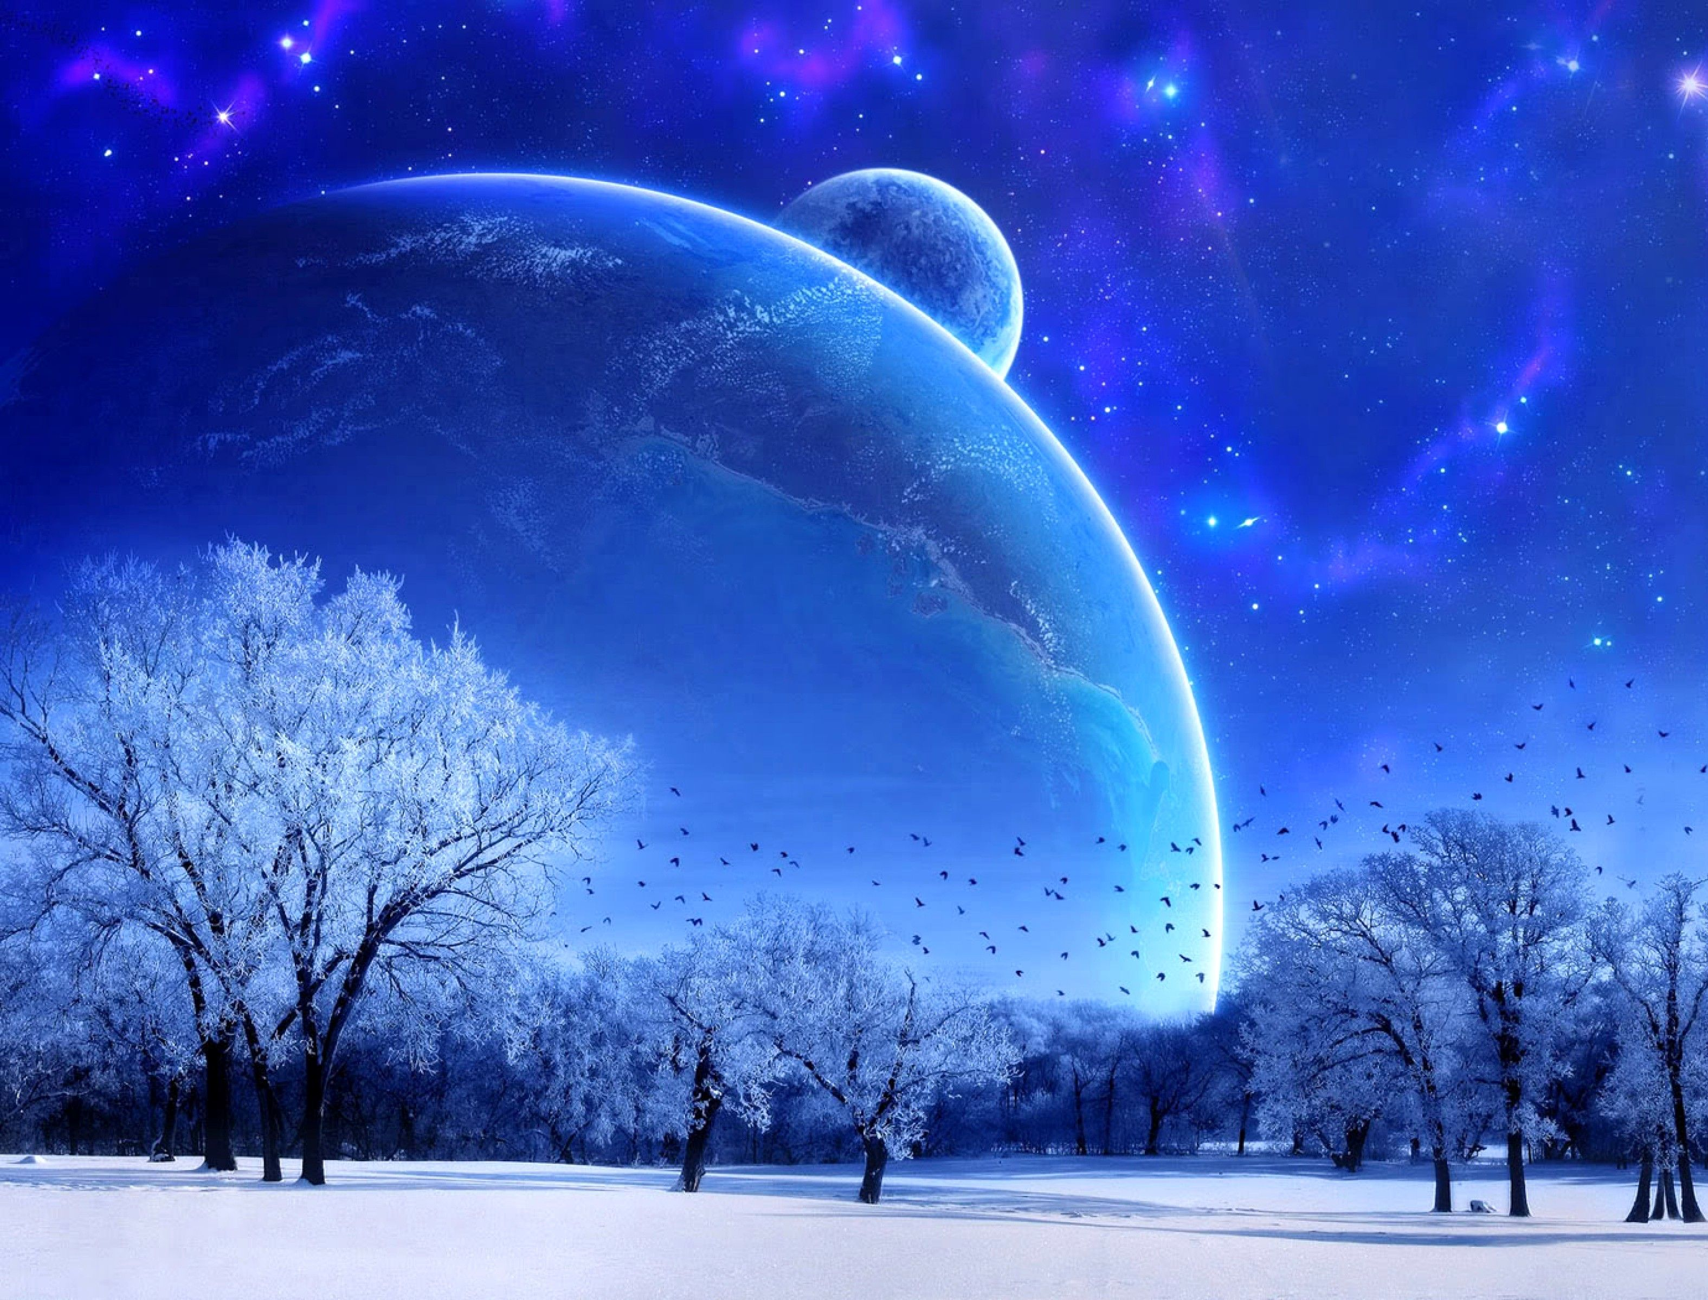
Chap4 Gravitation

Slide 2
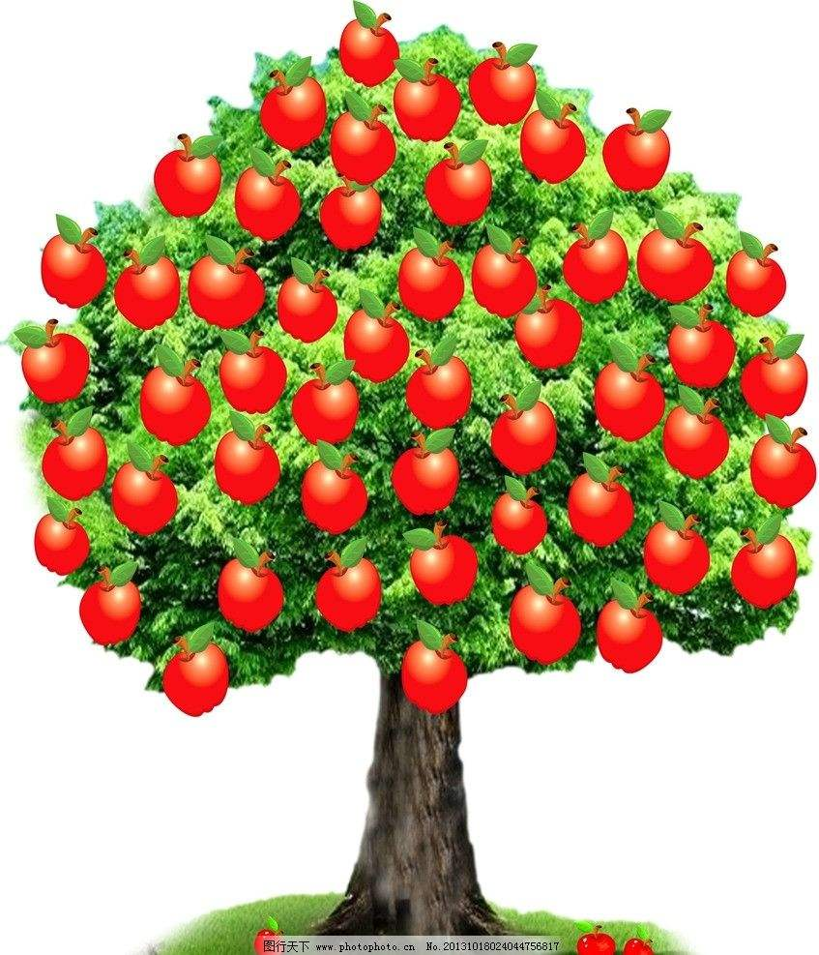
Newton’s Thought Experiment

Slide 3
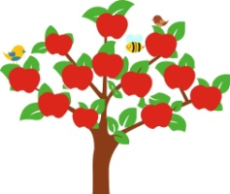

Slide 4
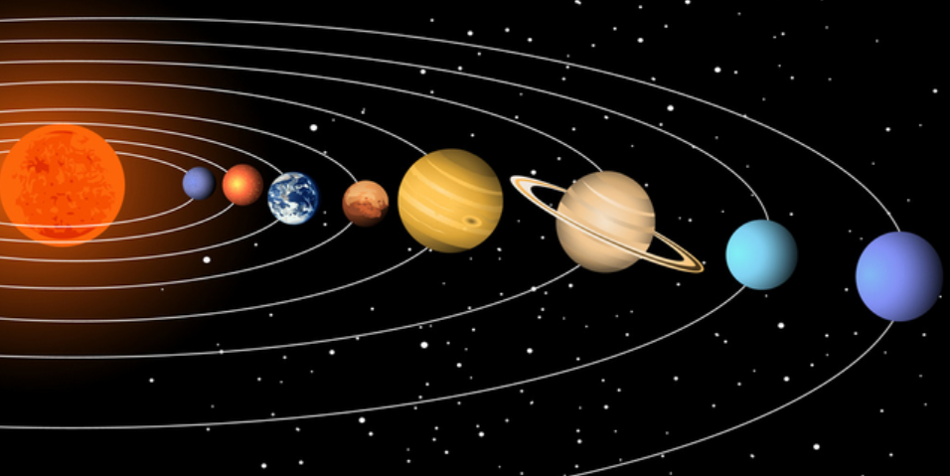
Galileo
Kepler
Descartes
Hooke
Newton

Slide 5
Newton’s Law of Universal Gravitation
Statement:
Every particle in the universe attracts every other particle with a force that is proportional to the product of their masses and inversely proportional to the square of the distance between them.
This force acts along the line joining the two particles.
Formula:
universality
gravitational constant
mutuality
(6.67×10⁻¹¹ N · m²/kg²)
independence
macroscopy
Gravitation of spherically symmetric bodies:
(a) F_{g} between two spherically symmetric masses m₁ & m₂…
(b) … is the same as if all the mass of each sphere is concentrated at the sphere’s center.
(a)
(b)

Slide 6
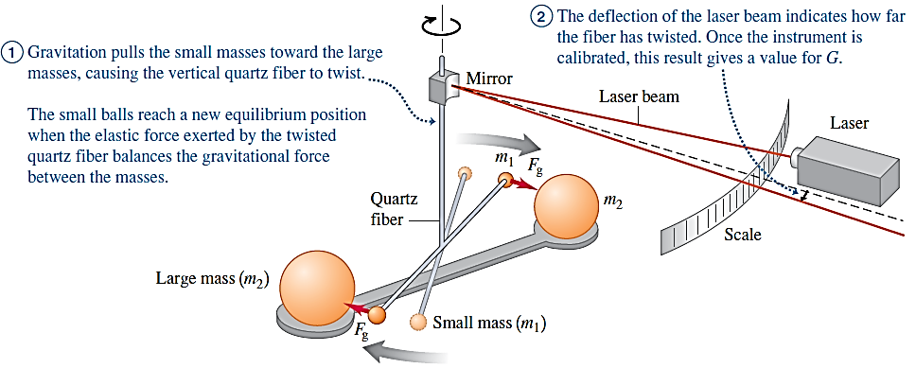
Determining the value of G:
Cavendish torsion balance
Test your Understanding of the Gravitation
The planet Saturn has about 100 times the mass of the Earth and is about 10 times farther from the Sun than the Earth is. Compared to the acceleration of the Earth caused by the Sun’s gravitational pull, how great is the acceleration of Saturn due to the Sun’s gravitation?
100 times greater (B) 10 times greater (C) the same
(D) $\frac{1}{10}$ as great (E) $\frac{1}{100}$ as great

Slide 7
Weight
Extended definition:
The weight of a body is the total gravitational force exerted on the body by all other bodies in the universe.
a body at the Earth’s surface
acceleration due to gravity at the Earth’s surface
a body at a point where the distance r from the center of the Earth (r > R_{E})

Slide 8
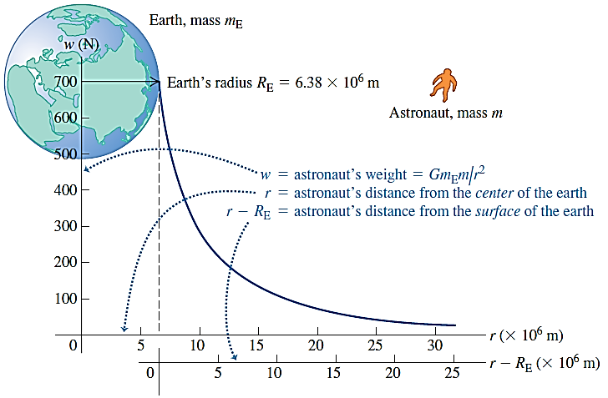
Test your Understanding of the Acceleration due to Gravity
Rank the following hypothetical planets in order from highest to lowest value of g at the surface:
(i) mass = 2 times the mass of the earth, radius = 2 times the radius of the earth;
(ii) mass = 4 times the mass of the earth, radius = 4 times the radius of the earth;
(iii) mass = 4 times the mass of the earth, radius = 2 times the radius of the earth;
(iv) mass = 2 times the mass of the earth, radius = 4 times the radius of the earth.
②
③
①
④

Slide 9
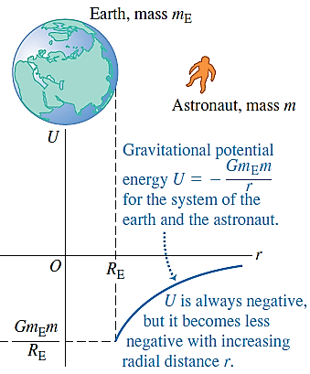
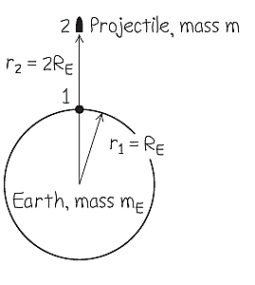
Gravitational Potential Energy
(r > R_{E})
(set r → ∞, U = 0)
Example: “From the earth to the moon”
In Jules Verne’s 1865 story with this title, three men went to the moon in a shell fired from a giant cannon sunk in the earth in Florida.
Find the minimum muzzle speed needed to shoot a shell straight up to a height above the earth equal to the earth’s radius R_{E}.
Neglect air resistance, the earth’s rotation, and the gravitational pull of the moon. The earth’s radius and mass are R_{E} = 6.38×10⁶ m and m_{E} = 5.97×10²⁴ kg.
(a)
Point 1 is at r = R_{E}, where the shell leaves the cannon with speed v₁ (the target variable); Point 2 is at r₂ = 2R_{E}, v₂ = 0, so K₂ = 0.
According to the energy-conservation equation,

Slide 10
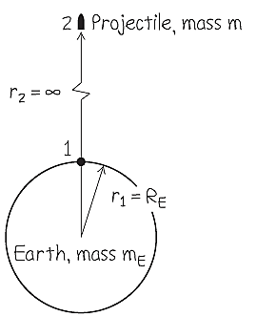
Example: “From the earth to the moon”
In Jules Verne’s 1865 story with this title, three men went to the moon in a shell fired from a giant cannon sunk in the earth in Florida.
(b) Find the minimum muzzle speed that would allow a shell to escape from the earth completely (the escape speed).
Neglect air resistance, the earth’s rotation, and the gravitational pull of the moon. The earth’s radius and mass are R_{E} = 6.38×10⁶ m and m_{E} = 5.97×10²⁴ kg.
(b)
In this case, r₂ = ∞, so U₂ = 0; v₂ = 0, so K₂ = 0
According to the energy-conservation equation,
escape velocity

Slide 11
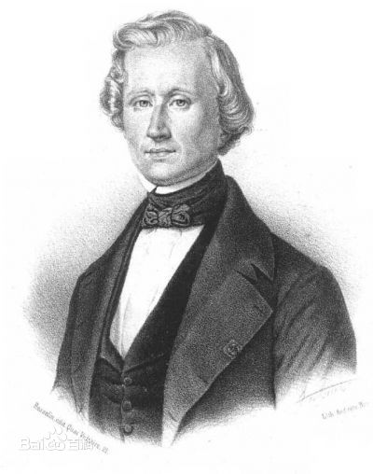
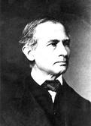
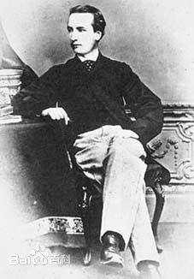
Application of Gravitation: Discovery of Unknown Planet
Jupiter
Mercury
Earth
Uranus
Venus
Mars
Saturn
Neptune

Slide 12
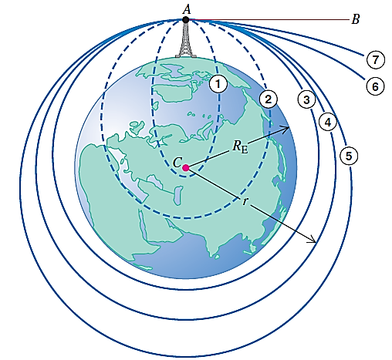
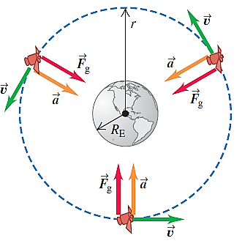
Application of Gravitation: Satellites
A projectile is launched from A toward B.
Trajectories ① through ⑦ show the effect of increasing initial speed.
Satellites: Circular Orbits
orbital velocity
larger orbits
slower speeds & longer periods

Slide 13
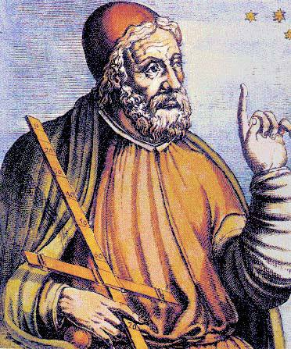
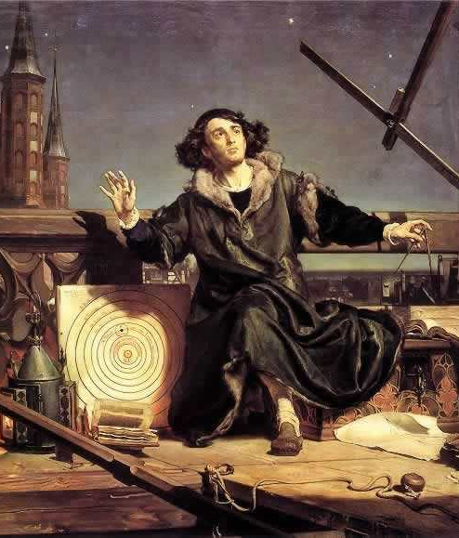
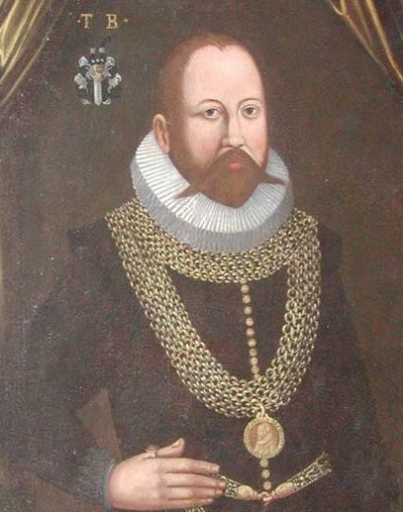
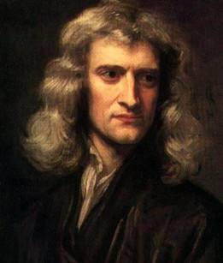
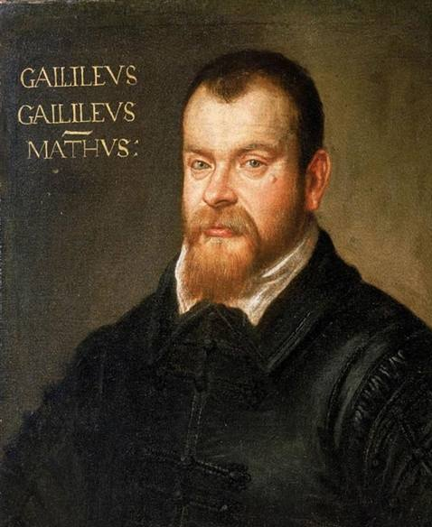
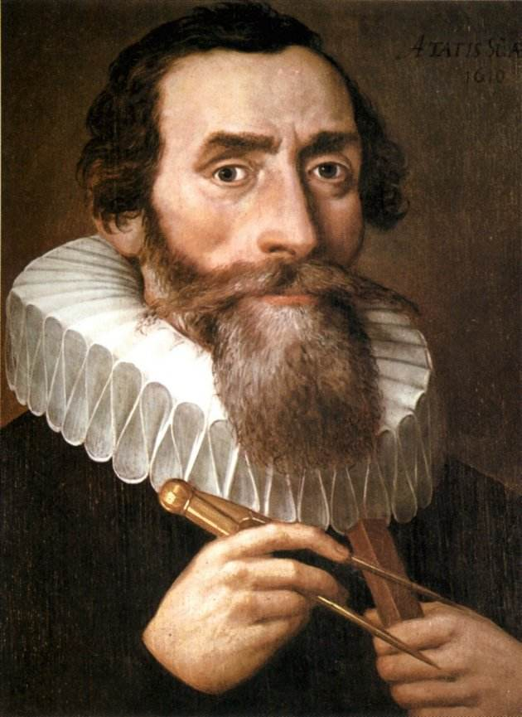
Ptolemy
Copernicus
Tycho
Newton
Galileo
Kepler

Slide 14
Kepler’s Laws of Planetary Motion
Kepler’s 1st Law:
Kepler’s 2nd Law:
Planet
P
1
perihelion
aphelion
4
Sun
△t
△t
Sun
★
S
S’
★
3
a
2
line SP sweeps out equal areas in equal times
elliptical orbit
Kepler’s 3rd Law:
Sun at one focus

