Slide 1
Homework
Make a list of things that you may want to try for the next 30 days.
Share your own experience 30 days later.
Read aloud the passage and try to imitate the speech.

Slide 2
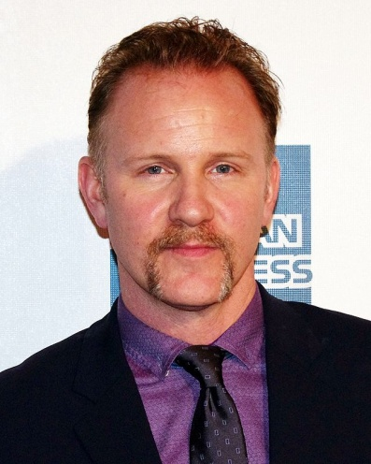
Morgan Spurlock:
Morgan Valentine Spurlock is an American documentary filmmaker, humorist, television producer, screenwriter, and political activist, best known for the documentary film Super Size Me.
Spurlock was the executive producer and star of the reality television series 30 Days. On June 2013, he became host and producer of the CNN show Inside Man.
http://en.wikipedia.org/wiki/Morgan_Spurlock

Slide 3
Super Size Me
The film depicts an experiment he conducted in 2003, in which he ate three McDonald's meals a day every day (and nothing else) for 30 days. And he also walked 1.5 miles a day just like what the average American does. He was of above average health and fitness when he started the project; he gained 25 pounds (11 kg), became quite puffy, suffered liver dysfunction and depression by the end. Spurlock's supervising physicians noted the effects caused by his high-carbohydrate diet—once even comparing it to a case of severe binge alcoholism.
After the completion of the project, it took Spurlock fourteen months to return to his normal weight of 185 pounds (84 kg).

Slide 4
Backgrounds
About this Talk
Is there something you've always meant to do, wanted to do, but just ... haven't? Matt Cutts suggests: Try it for 30 days. This short, lighthearted talk offers a neat way to think about setting and achieving goals.
About the Speaker
Matt Cutts is an engineer at Google, where he fights linkspam and helps webmasters understand how search works.

