Slide 1
Ch. 6 - Electron configurations
and Radioactivity

Slide 2
不同时期的原子结构模型:
1.古希腊原子论
2.道尔顿原子模型(1803年)
3.汤姆生原子模型(1904年)
4.卢瑟福原子模型(1911年)
5.玻尔原子模型(1913年)
6.电子云模型(1926年)

Slide 3
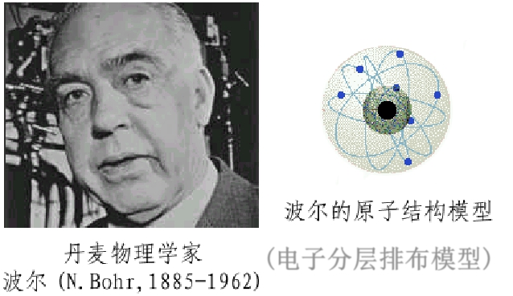
5.玻尔原子模型(1913年)
电子在原子核外空间的一定轨道上绕核
做高速的圆周运动。

Slide 4
1eV≈1.6×10⁻¹⁹ J

Slide 7
[mju]

Slide 10
Each element has a unique bright-line emission spectrum.
“Atomic Fingerprint”
Helium

Slide 11
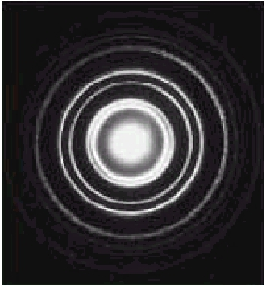
Electrons as Waves
EVIDENCE: DIFFRACTION PATTERNS
VISIBLE LIGHT
ELECTRONS

Slide 14
6.电子云模型(1926年)

Slide 16
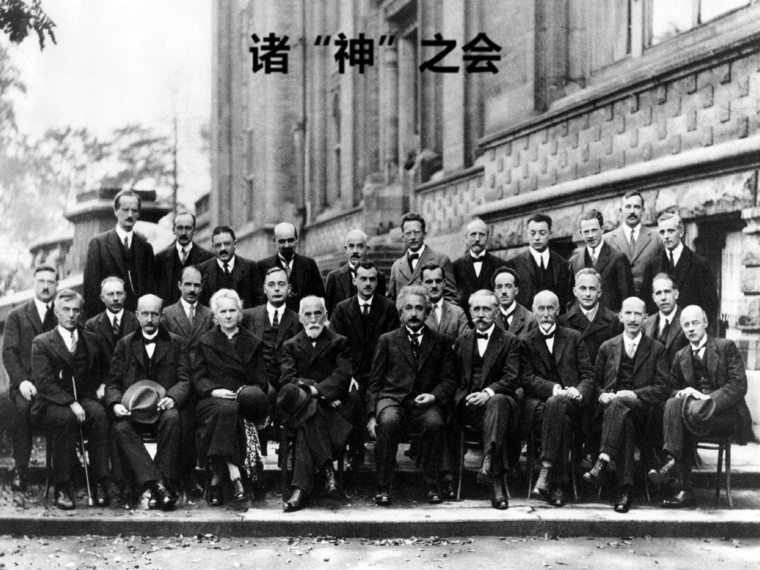
薛定谔
海森堡
德布罗意
泡利
狄拉克
德拜
玻尔
居里夫人
朗之万
普朗克
洛伦兹
爱因斯坦
1927年第五届索尔维会议

Slide 18
Quantum Numbers

Slide 19
Quantum Numbers

Slide 20
Quantum Numbers

Slide 21
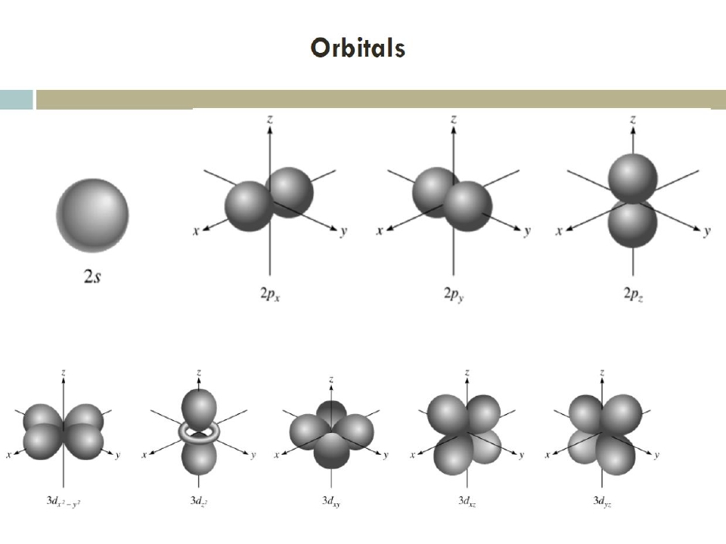

Slide 22
Quantum Numbers

Slide 23
Quantum Numbers

Slide 24
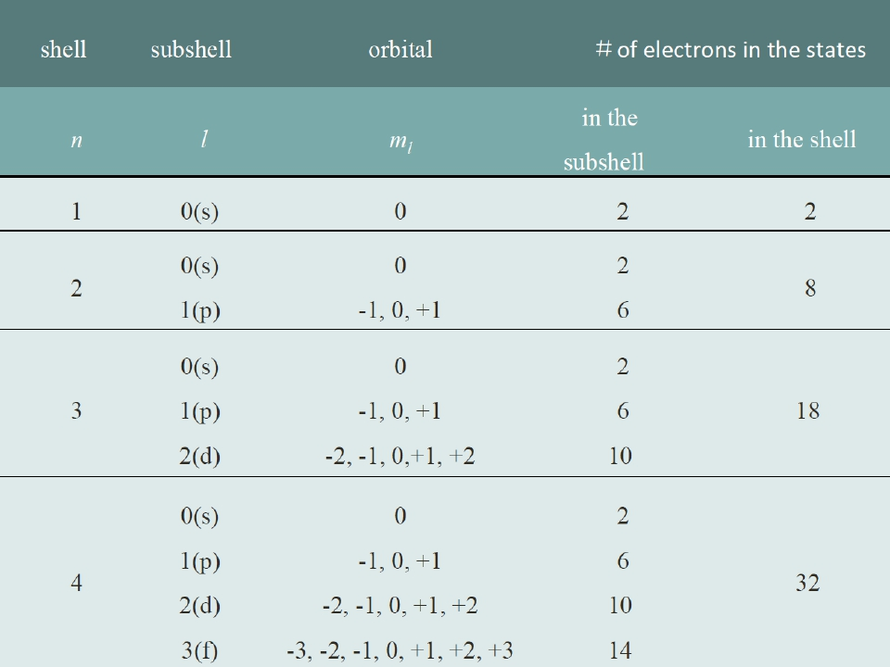

Slide 25
Quantum Numbers
n
主量子数
l
_{角量子数}
0
0
1
0
1
2
0
-1
m_{l}
_{磁量子数}
0
0
0
0
0
-1
+1
+1 -1 +2 -2
+1
m_{s}
_{自旋量子数}

Slide 26
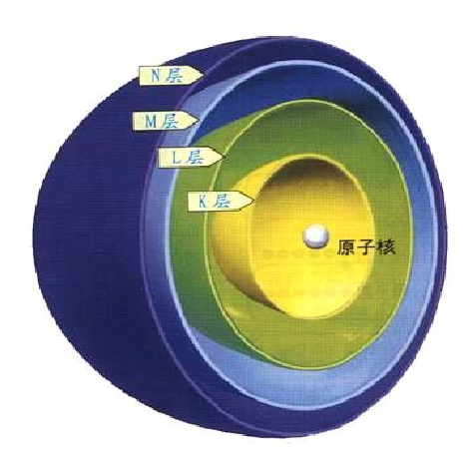
核外电子是怎样排布的？

Slide 27
Electron Configuration

Slide 28
Electron Configuration

Slide 30
n
主量子数
l
_{角量子数}
0
0
1
0
1
2
+1
0
0
-1
m_{l}
_{磁量子数}
0
0
0
-1
+1
0
+1 -1 +2 -2
m_{s}
_{自旋量子数}

Slide 31
Electron Configuration

Slide 32
Electron Configuration

Slide 34
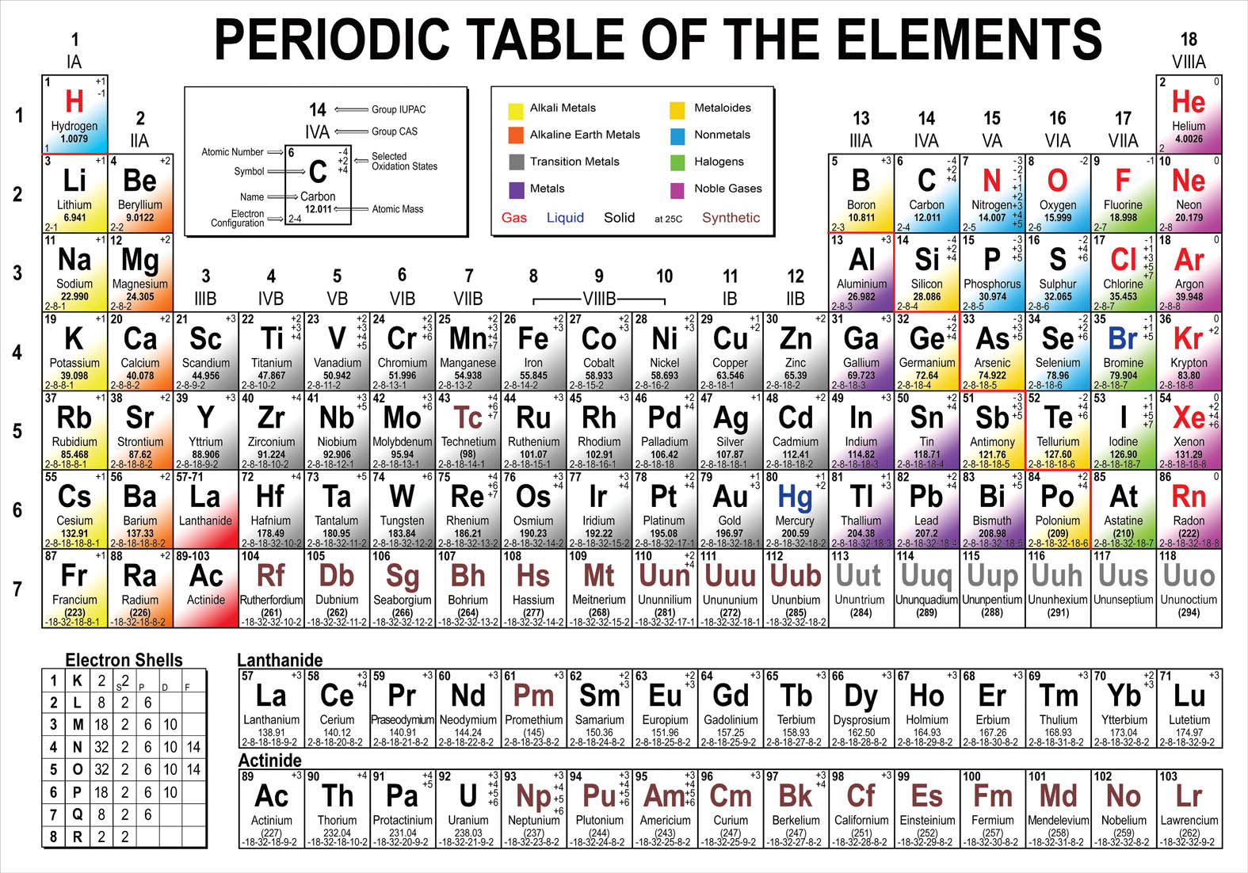

Slide 36
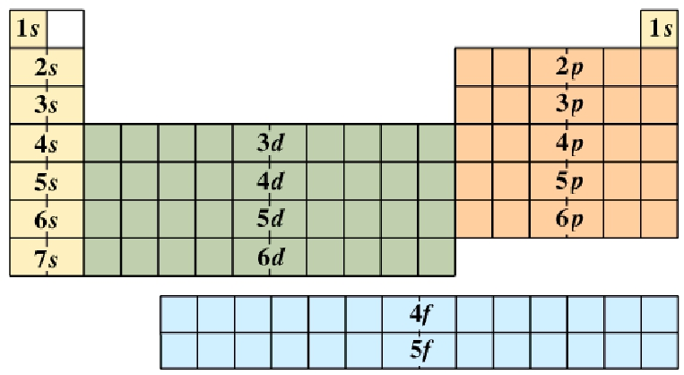
Periodic Patterns
s
p
1
2
3
4
5
6
7
d (n-1)
f (n-2)
6
7

Slide 38
I. RadioactiveDecay

Slide 39
A. Types of Radiation

Alpha particle (α)
 helium nucleus
4
2
He
paper
2+
✦ Beta particle (β-)
⬥ electron
✦ Positron (β+)
⬥ positron
0
-1
1-
e
lead
0
+1e
1+
✦ Gamma (γ)
⬥ high-energy photon
concrete
0

Slide 40
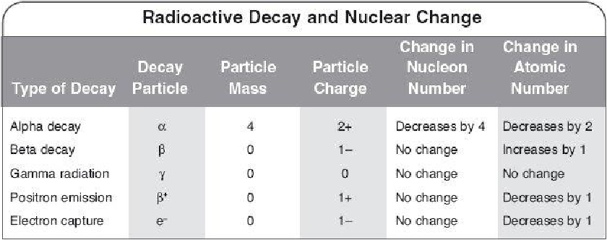
B. Nuclear Decay

Slide 41
B. Nuclear Decay

Alpha Emission
238
92
U→
Th+ He
234 4
90 2
parent
nuclide
daughter
nuclide
alpha
particle

Slide 42
C. Half-life

Slide 43
C. Half-life
✦ A 16-gram radioactive sample decays to two grams
over a period of 30 years. What is the half-life of this
substance?
Solution:
This sample underwent three half-life periods as
shown here:
16 grams → 8 grams → 4 grams → 2 grams
If the total time for three half-life periods is 30 years,
then each half-life period, as represented by the
arrows in the diagram, is 10 years.

Slide 44
II. Fission&Fusion

Slide 45
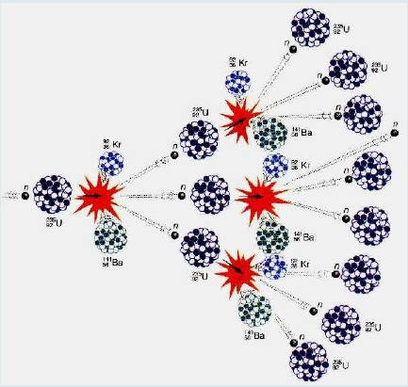
A. Fission

chain reaction - self-propagating reaction

Slide 46
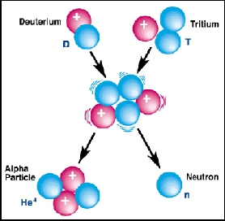
B. Fusion
combining of two nuclei to form one nucleus of larger mass
thermonuclear reaction – requires temp of 40,000,000 K to sustain
1 g of fusion fuel =20 tons of coal
occurs naturally in stars
2
1
H+ H
3
1

Slide 47
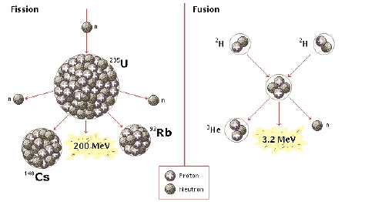
C. Fission vs. Fusion
F
I
S
S
I
O
N
F
U
S
I
O
N
 235U
is limited

fuel is abundant



danger of meltdown
toxic waste
thermal pollution



no danger of meltdown
no toxic waste
not yet sustainable

