Slide 1
第七节-分子光谱学

Slide 5
Practice 1
(b). 5.4 μM (values between 5.2 μM and 5.6 μM are acceptable)
(c). Less than.
The diluted solution will have a lower concentration and therefore a lower absorbance, in accordance with Beer’s law
(d). Less than.
559 nm is the wavelength of maximum absorbance. The absorbance at any other wavelength will be lower.

Slide 6
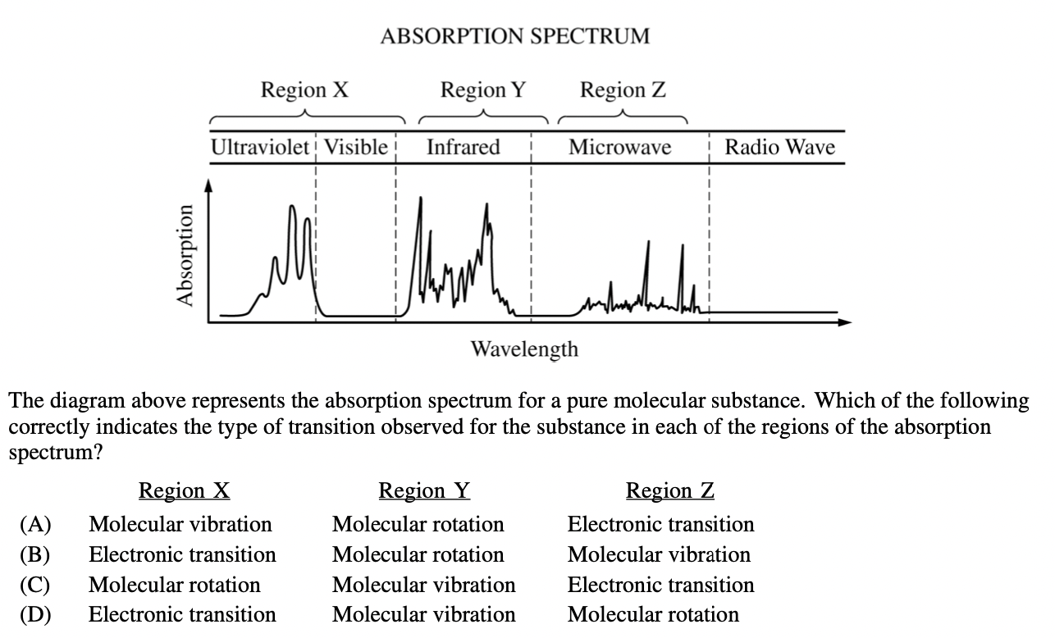
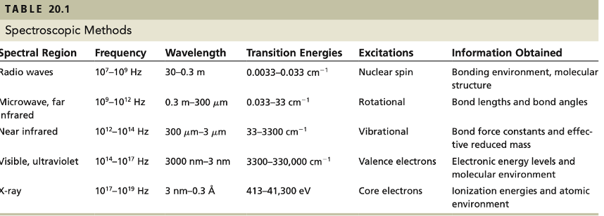
Practice 2

